Slide 1
Sounds Great Readers 2nd Edition
ⓒ 2021 Compass Publishing
MY BOOK REPORT
Name :
Date :
Title :
Rating :
Draw a picture you like from the book.
Write a phrase you like from the book.

Slide 2
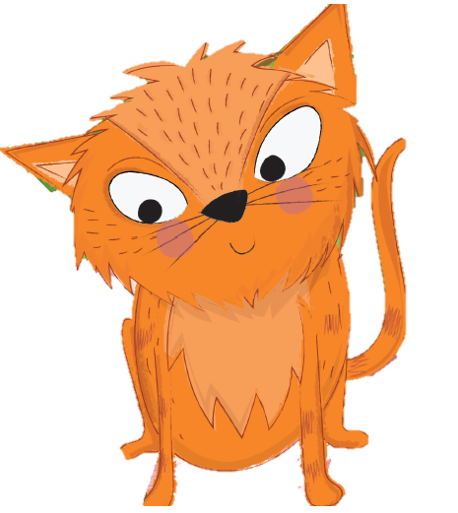
Sounds Great Readers 2nd Edition
ⓒ 2021 Compass Publishing
Rating :
Name :
Date :
Draw a picture you like from the book.
Write a phrase you like from the book.

Slide 3
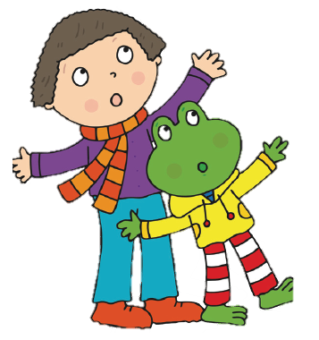
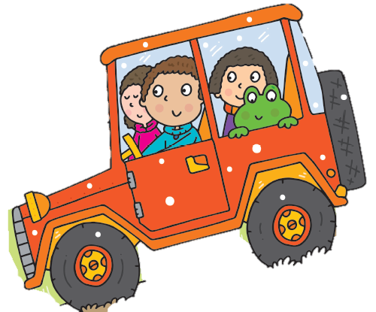
Sounds Great Readers 2nd Edition
ⓒ 2021 Compass Publishing
Rating :
Name :
Date :
Draw a picture you like from the book.
Write a phrase you like from the book.

Slide 4
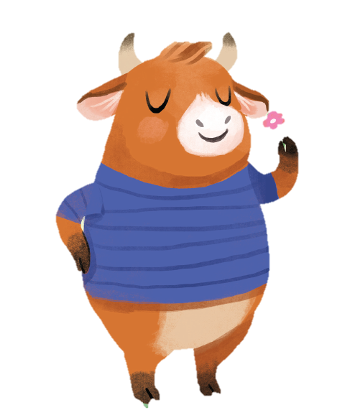
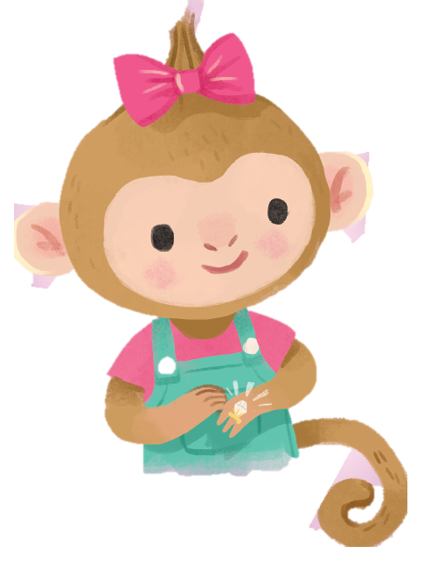
Sounds Great Readers 2nd Edition
ⓒ 2021 Compass Publishing
Rating :
Name :
Date :
Draw a picture you like from the book.
Write a phrase you like from the book.

Slide 5
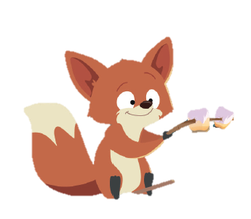
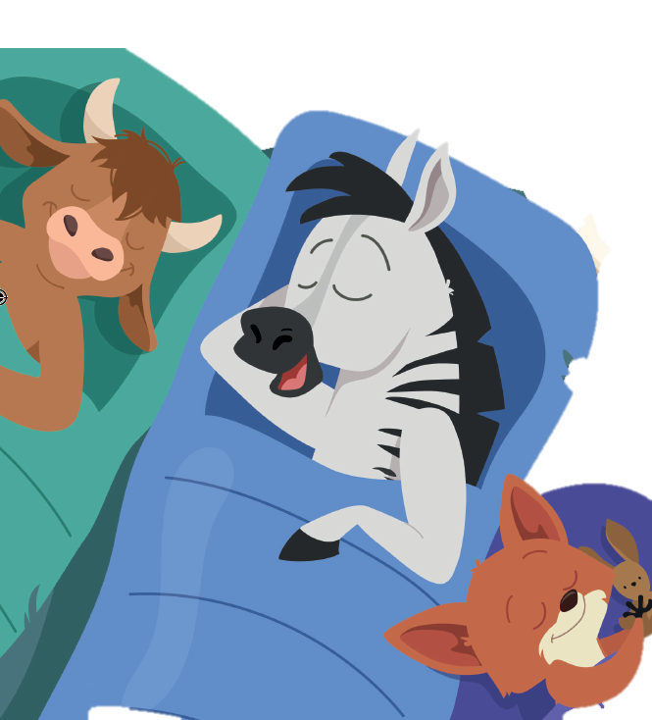
Sounds Great Readers 2nd Edition
ⓒ 2021 Compass Publishing
Rating :
Name :
Date :
Draw a picture you like from the book.
Write a phrase you like from the book.

