Slide 2
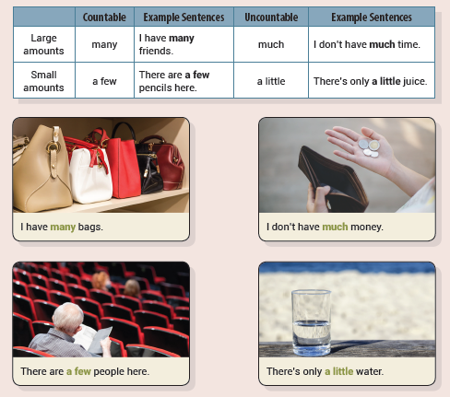
Unit 1 I Don’t Have Much Time
UNIT OBJECTIVE: You will be able to use quantifiers.

Slide 4
much
many
much

Slide 5
I don’t need much juice.
Will you eat much chocolate?
I don’t read many books.
He drank a little water.

Slide 6
a few
a little
a few
much

Slide 7
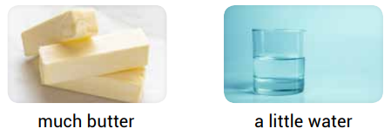
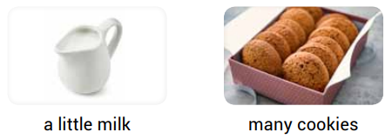
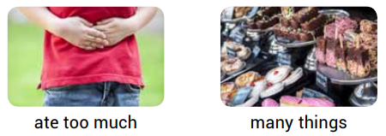
a little
a little
many
many
much

Slide 8
many
a few
many
a few

Slide 9
many
a little
a few
a little
a little

Slide 10
There will be a little snow later
They ate a little pizza
I can play a few instruments
There are many people here

Slide 11
any
ew
any
any
ittle

Slide 12
Unit 2 How Many People Are There?
UNIT OBJECTIVE: You will be able to use How many…? and How much…?

Slide 15
a few
are
much
is

Slide 16
How much
How much
How many

Slide 17
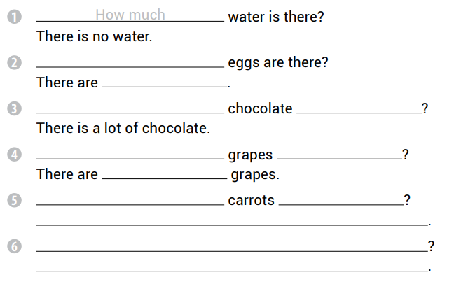
How many
six eggs
How much
is there
How many
are there
a few
How many
are there
There are five carrots
How much apple juice is there
There is a lot of apple juice

Slide 18
much
is
much
is
many
are
many
are

Slide 19
much
is
many
are
many
are
much
is
much
is

Slide 21
How many
how many
how much

Slide 22
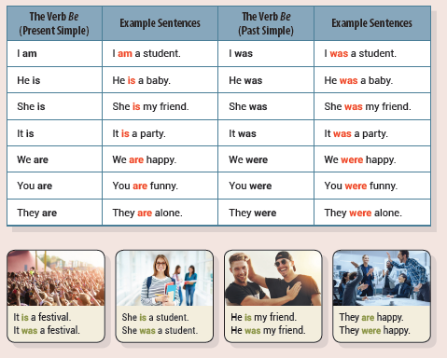
Unit 3 I Was a Student
UNIT OBJECTIVE: You will be able to distinguish between the present simple tense and the past simple tense of the verb be.

Slide 24
was
is
are
am

Slide 26
is
was
were
is

Slide 27
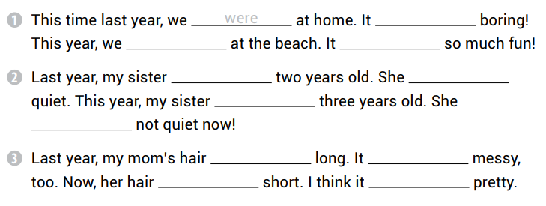
was
are
is
was
was
is
is
was
was
is
is

Slide 28
am
is
is
is

Slide 29
was
was
wasn’t
were
was

Slide 30
George is upstairs
Was your backpack here
Her music was loud
The cats were on the roof

Slide 31
was
were
were
was
was
was
am
is

Slide 32
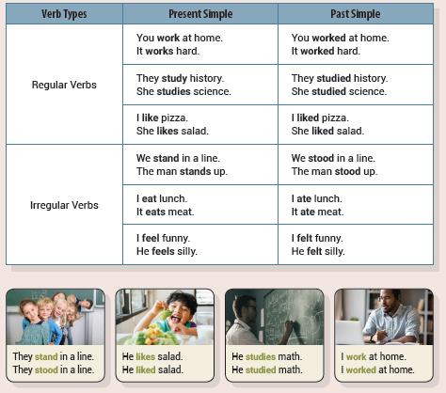
Unit 4 I Like Pizza
UNIT OBJECTIVE: You will be able to distinguish between the present simple tense and the past simple tense with more verbs.

Slide 36
see
closed
goes
visited

Slide 37
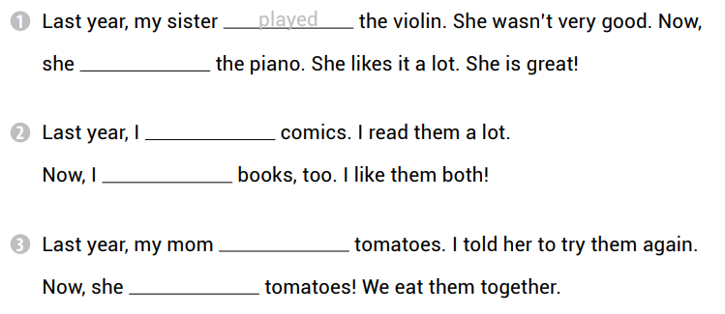
plays
read
read
didn’t eat
loves

Slide 38
plays
bite
sings
visits
close
stand
feel

Slide 39
sang
visited
played
came
drank
went

Slide 41
made
tasted
watched
played
ran
drank
didn’t want

Slide 42
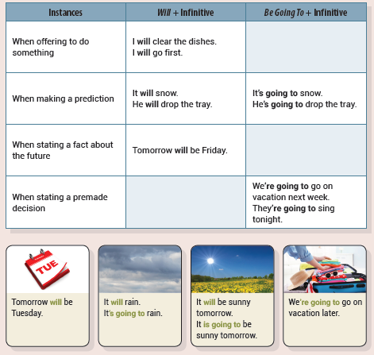
Unit 5 It Is Going to Rain
UNIT OBJECTIVE: You will be able to use will and be going to to talk about the future.

Slide 44
is going to yell
are going to ride
will ring
is going to drop

Slide 45
She will take the bus.
I am going to go to the gym.
She will call her parents.
This movie is going to make me laugh.

Slide 47
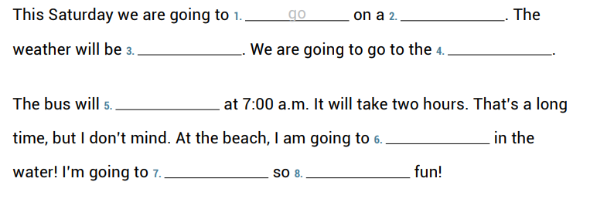
trip
sunny
beach
leave
swim
have
much

Slide 48
Gary is going to be the winner.
The bus is going to be late.
I will hate this.
We will get lost.
The store is going to close.
It will taste spicy.

Slide 49
This will be exciting!
Dad is going to be home late today.
I am going to get an email later.
The movie is going to be scary.
You will burn yourself.
There are going to be many people there.
The park is going to be busy.
We will be hungry soon.

Slide 50
They are going to see a movie
We will win the game
The sun will rise at 6:00 a.m
It’s going to be fun

Slide 51
are going to go
will open
am going to order
are going to have
are going to play
will have
will come

Slide 52
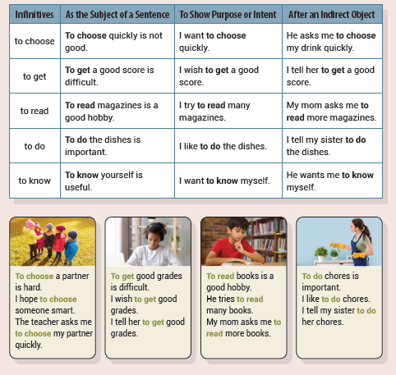
Unit 6 I Like to Do Chores
UNIT OBJECTIVE: You will be able to use infinitives.

Slide 55
to drink
to come
to walk
to go

Slide 56
to be
to eat
to do
to clean

Slide 57
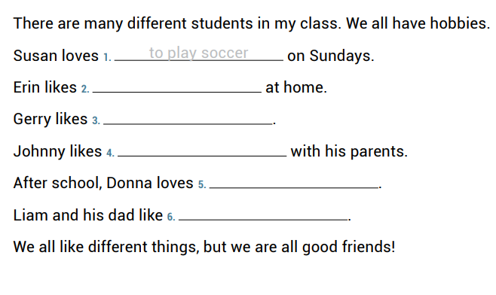
to play with dolls
to ride his bike
to bake bread
to paint pictures
to go fishing

Slide 58
to see
to brush
to go
To be

Slide 59
to come
to sit
to buy
to get
to wake

Slide 60
I need you to come quickly
He needs to finish his homework
I want to see that movie
She loves to ride horses
I want to get some rest

Slide 62
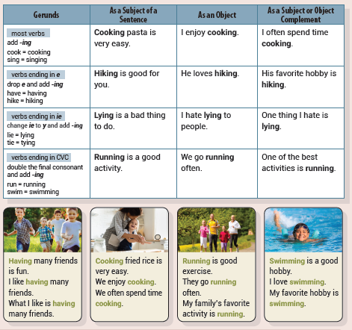
Unit 7 I Enjoy Cooking
UNIT OBJECTIVE: You will be able to use gerunds.

Slide 65
Waking up
going
making
living

Slide 66
fishing
taking
studying
seeing

Slide 67
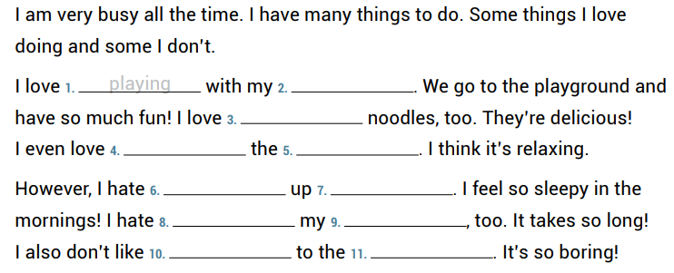
sister
eating
washing
dishes
waking
early
cleaning
room
going
store

Slide 68
dancing
Making
painting
listening

Slide 69
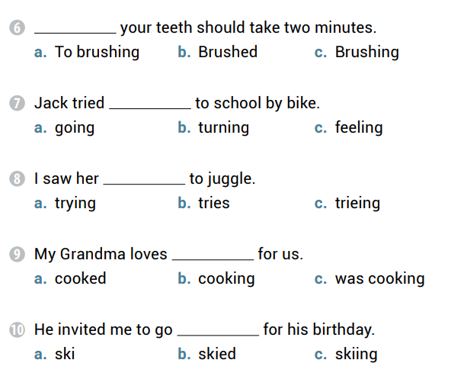
Brushing
going
trying
cooking
skiing

Slide 70
He goes running
I see her doing chores
She likes drinking hot chocolate
Mom watches him playing baseball

Slide 71
Watching
Eating
eating
drinking
watching
talking
watching

Slide 72
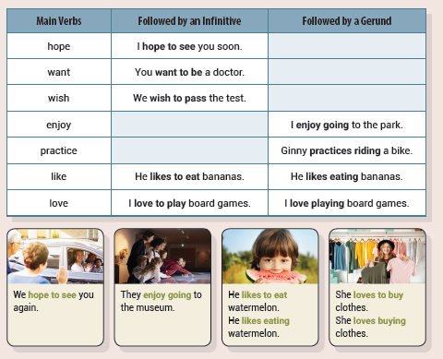
Unit 8 I Love to Play Board Games
UNIT OBJECTIVE: You will know when to use gerunds and when to use infinitives.

Slide 75
doing
to come
jumping
to stop

Slide 76
drinking
to be
to have
to listening

Slide 77
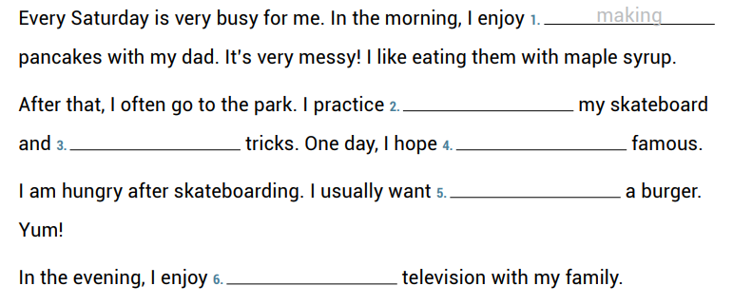
riding
doing
to be
to eat
watching

Slide 78
to become
to go
to see
to play

Slide 79
to meet
wearing
going
watching
to try

Slide 80
My brother practices playing the guitar
They love opening presents
Mom enjoys talking on the phone
We hope to be winners

Slide 81
playing
to listen
to play
to play
to be
to go

Slide 82
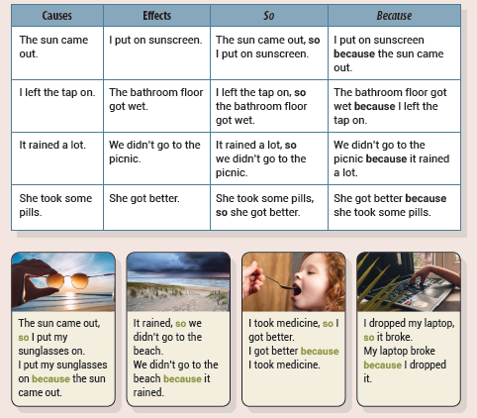
Unit 9 The Sun Came Out, So I Put My Sunglasses On
UNIT OBJECTIVE: You will learn about the conjunctions because and so.

Slide 85
because
so
because
so

Slide 86
I need a haircut because my hair is too long.
I feel sick because I ate too much.
I held Mom’s hand because it was busy outside.
I bought a new top because my T-shirt was too small.

Slide 87
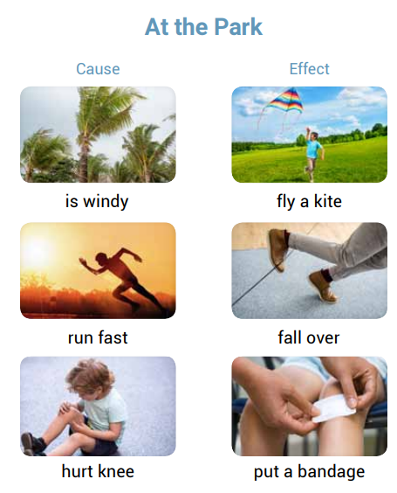
fly
is
run
fall
hurt
puts

Slide 88
I opened the door, so the cat ran outside.
He ate a lot for breakfast because he was hungry.
I am sad because I can’t go to the party.
My house is far away, so I have to take a taxi.
I open the window because it’s warm.
I am drawing a picture, so I need more pencils.

Slide 89
Dad was happy because I cleaned the car.
The car stopped because the light was red.
It was raining, so I stayed inside.
I used a brush because my hair was messy.
It was his bedtime, so he went upstairs.
The sky is clear, so I can see the moon.
I hugged my mom because I was sad.
There is a traffic jam because there are many cars.

Slide 90
I gave her some milk
it snowed in July
he was scared
they were on vacation

Slide 91
because
so
because
so
because

Slide 92
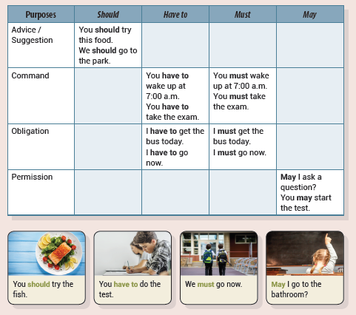
Unit 10 I Have to Go Now
UNIT OBJECTIVE: You will learn about the modal verbs should, have to, must, and may.

Slide 96
must not
shouldn’t
have to
may

Slide 97
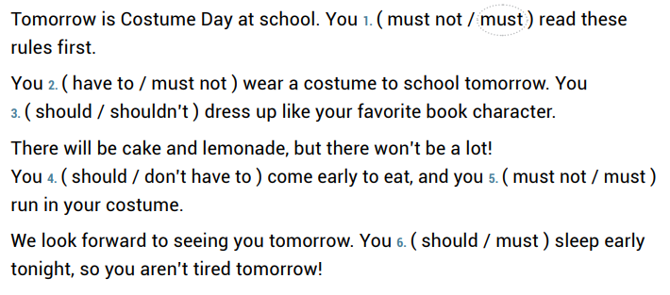

Slide 98
I don’t have to sing in the school play.
We must not lose the key.
You may have a present.
They should not wake up the baby.
You must not miss the train.
I should eat a healthy salad.

Slide 99
You must take your medicine.
We have to go by airplane.
You should drink enough water.
You may borrow my toys.
I have to clean my room before dinner.
We don’t have to eat dessert.
I must not fail the test.
You may bring a toy.

Slide 100
We have to go home
You should wash the rice
I must remember
May I go to the park

Slide 101
should
may
may
must not
have to
don’t have to
should not

