Slide 2
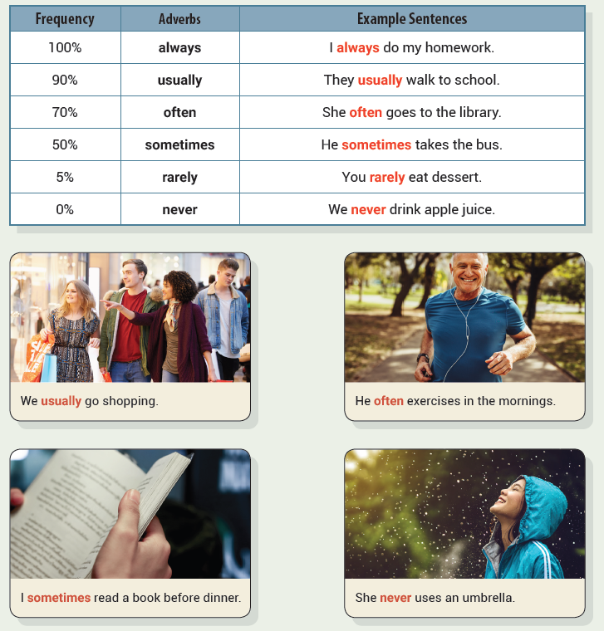
Unit 1 I Always Do My Homework
UNIT OBJECTIVE: You will be able to use frequency adverbs.

Slide 7
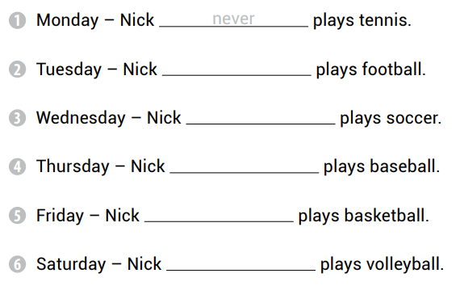
sometimes
often
usually
always
rarely

Slide 8
Kelly sometimes bakes cookies.
I never listen to the radio.
My brother never answers the phone.
She usually washes the dishes.
They sometimes feed the birds.
I rarely go to the beach.

Slide 9
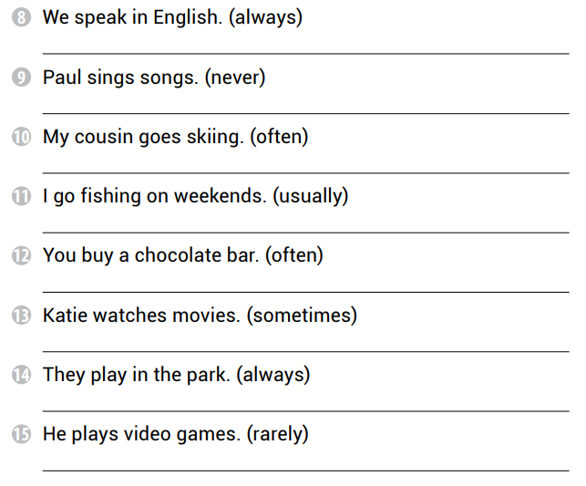
We always speak in English.
Paul never sings songs.
My cousin often goes skiing.
I usually go fishing on weekends.
You often buy a chocolate bar.
Katie sometimes watches movies.
They always play in the park.
He rarely plays video games.

Slide 10
She sometimes plays the piano
We often play video games
They never eat meat
He always uses the computer

Slide 12
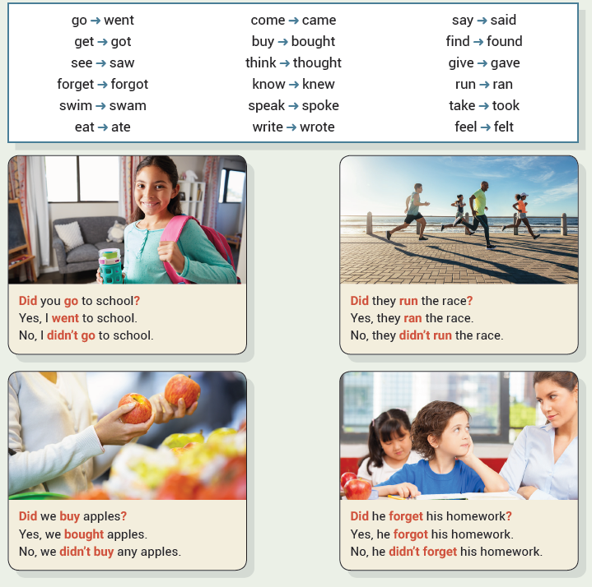
Unit 2 I Went to School
UNIT OBJECTIVE: You will be able to use irregular verbs in the past simple tense.

Slide 15
thought
saw
found

Slide 17
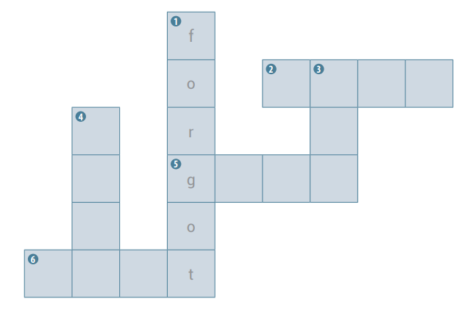
s
a
i
d
c
t
a
a
v
e
m
w
e
n

Slide 18
heard
caught
sat
paid
broke
drove

Slide 19
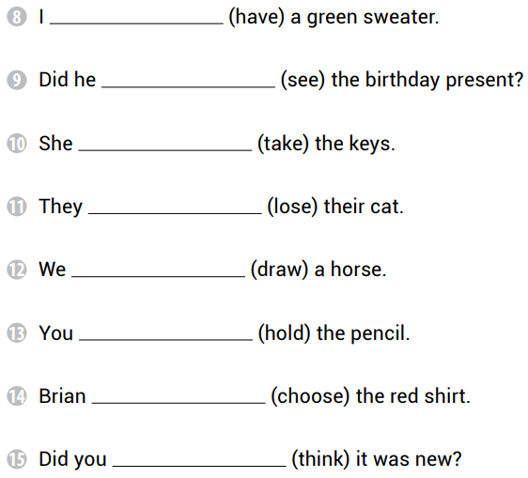
had
see
took
lost
drew
held
chose
think

Slide 20
We knew the answer
I sat on the chair
He left on Friday
They got a kitten

Slide 21
paid
lost
felt
said
found

Slide 22
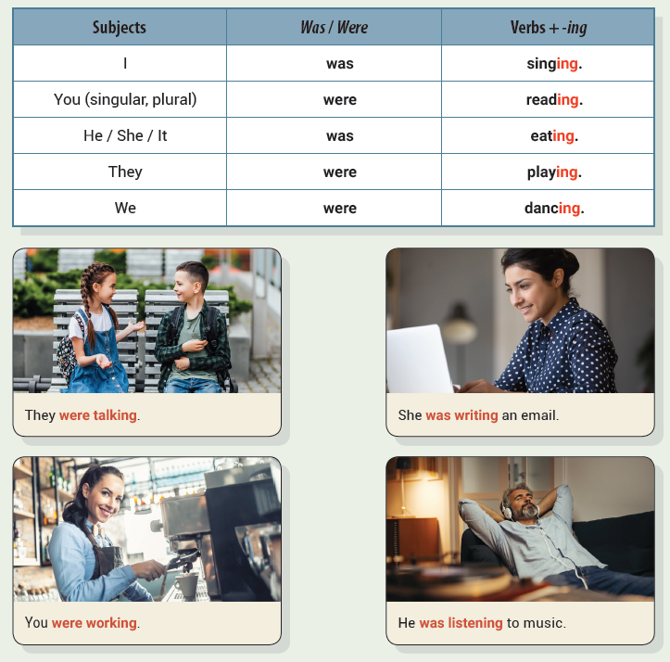
Unit 3 They Were Talking
UNIT OBJECTIVE: You will be able to use the past continuous tense.

Slide 25
were playing
was talking
was using

Slide 27
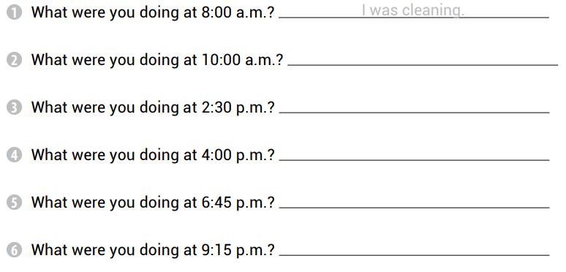
I was riding a bike.
I was studying.
I was watering the plants.
I was eating dinner.
I was watching a movie.

Slide 28
They were reading.
She was smiling.
You were swimming.
We were playing.
I was singing.
It was moving.

Slide 29
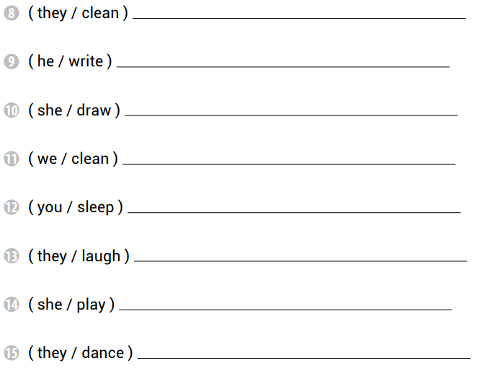
They were cleaning.
He was writing.
She was drawing.
We were cleaning.
You were sleeping.
They were laughing.
She was playing.
They were dancing.

Slide 30
were playing
was writing
were driving
was flying

Slide 32
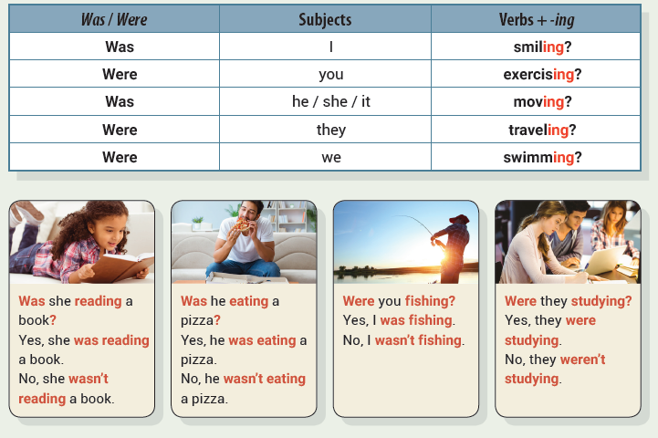
Unit 4 I Wasn’t Sleeping
UNIT OBJECTIVE: You will be able to use the past continuous tense in negatives and questions.

Slide 36
They weren’t enjoying the concert.
I wasn’t working at the library.
We weren’t playing soccer at the park.

Slide 38
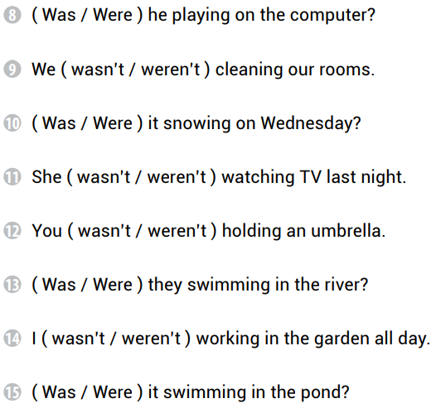

Slide 39
No, we weren’t having fun.
No, they weren’t eating breakfast.
No, you weren’t playing volleyball.

Slide 40
Yes, I was watching TV.
Yes, they were camping.
No, you weren’t exercising at the gym.
Yes, he was driving a car.
No, he wasn’t walking with his friends.
No, we weren’t talking on the phone.

Slide 41
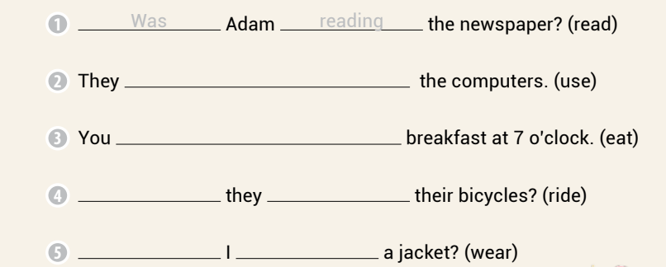
weren’t using
weren’t eating
Were
riding
Was
wearing

Slide 42
wasn’t
wasn’t
wasn’t
weren’t
was

Slide 43
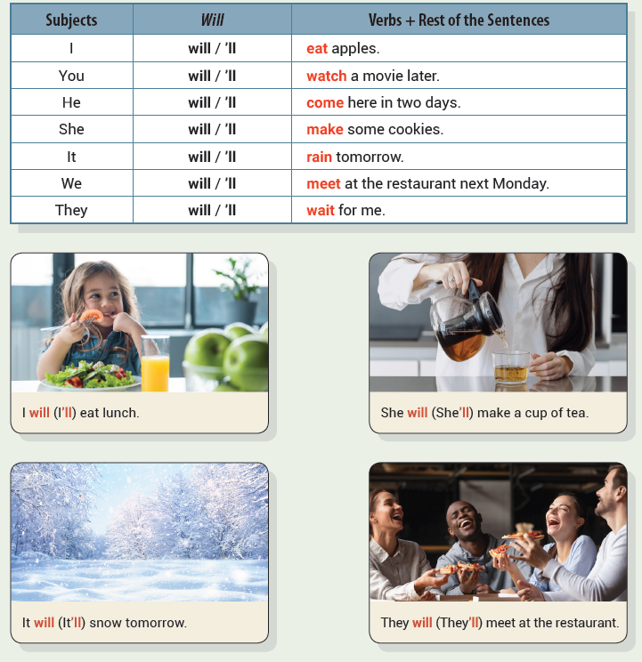
Unit 5 I Will Eat Lunch
UNIT OBJECTIVE: You will be able to use will in the future simple tense.

Slide 45
will open
will ride
will have

Slide 46
I will play the piano
You will brush the cat
He will talk on the phone

Slide 47
will work
will finish
will make
will take

Slide 48
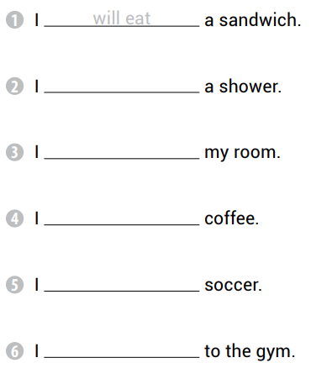
will take
will clean
will drink
will play
will go

Slide 49
will help
will rain
will study
tomorrow

Slide 50
tomorrow
will read
tonight
will help
will assist

Slide 51
We will travel to Canada next summer
I will work in London next year
It will snow tomorrow
Bob will finish his homework

Slide 53
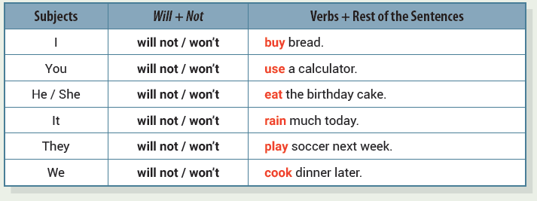
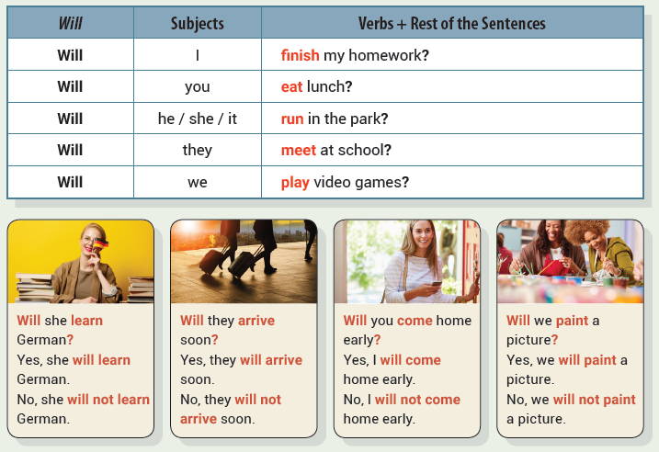
Unit 6 I Will Not Buy Bread
UNIT OBJECTIVE: You will be able to use will to talk about the future in negatives and questions.

Slide 56
I will not study at the library.
It will not snow next week.
You will not play basketball.

Slide 57
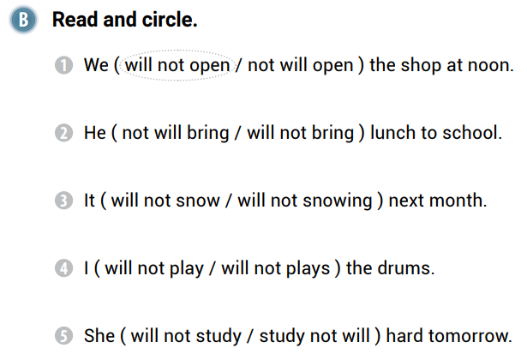

Slide 58
it will not rain all day
he will not play with the toy
I will not sail on a boat

Slide 59
I will not watch a movie
they will not study in the classroom
you will not read a book
we will not go to the shopping mall
she will not go running
he will not finish the puzzle

Slide 60
She will not buy a new phone
Will I go to the swimming pool
You will not study for the test
Will we eat pizza tonight
It will not rain heavily tomorrow
Will I meet my teacher at 3:00 p.m.

Slide 61
He will not bring a present
Will she work on the computer
We will not meet at the library
Will they go ice skating
You will not pay $10
Will your uncle fix your car
It will not take a photograph
Will I study all night

Slide 62
I will play golf on the weekend
She will cook steak tonight
Will we eat ice cream tonight
They will visit France next month

Slide 63
will not
will
will not
will
will not

Slide 64
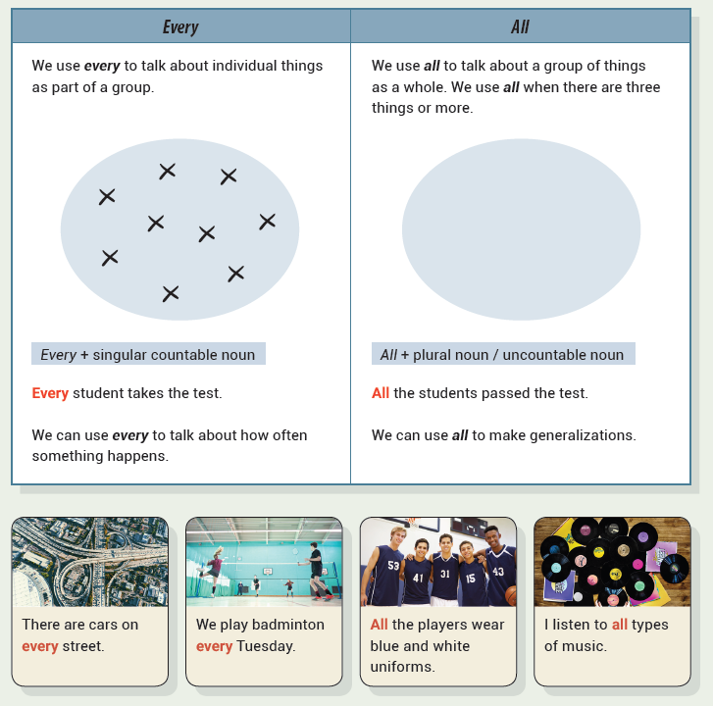
Unit 7 Every Student Takes the Test
UNIT OBJECTIVE: You will be able to use every and all as determiners in a sentence.

Slide 67
I kiss every teddy bear at night.
All sharks are dangerous.
I drank all the milk.

Slide 69
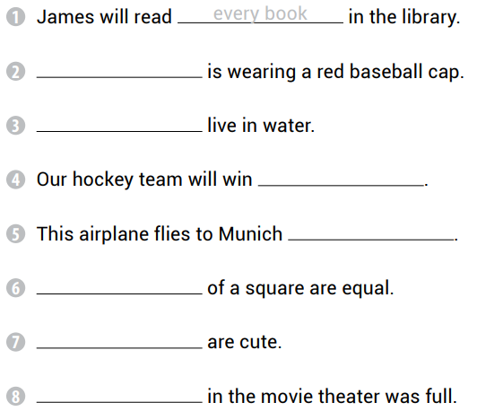
Every player
All fish
every game
every day
All sides
All cats
Every seat

Slide 70
every
All
every
all

Slide 71
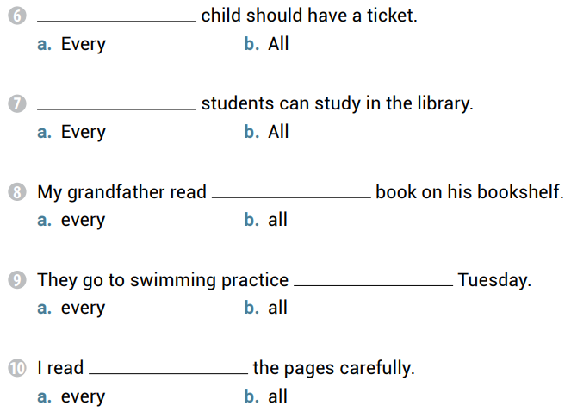
Every
All
every
every
all

Slide 72
I spent all my money on a new phone.
He wears a ring on every finger.
I don’t understand every word in the book.
All children need love and care.

Slide 74
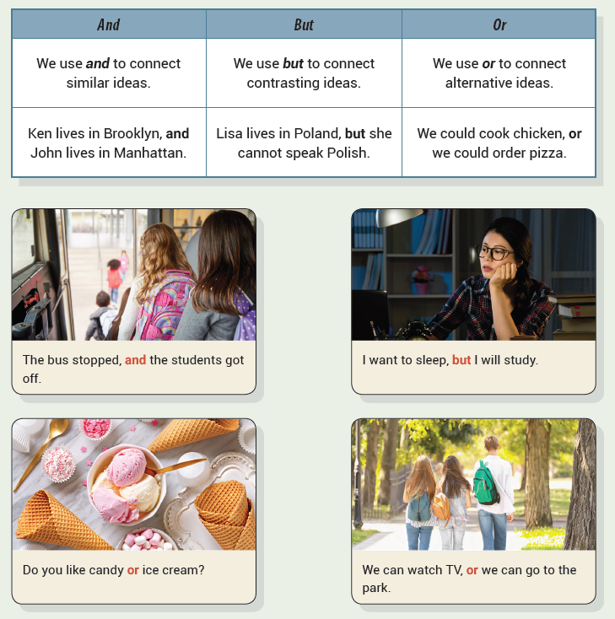
Unit 8 She Plays the Piano and the Guitar
UNIT OBJECTIVE: You will be able to use and, but, and or as conjunctions in a sentence.

Slide 78
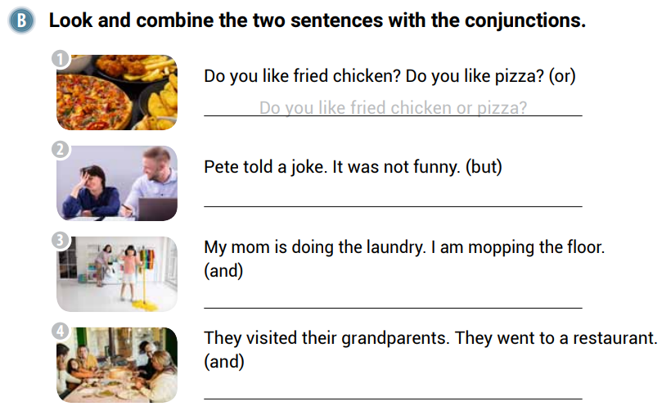
Pete told a joke, but it was not funny.
My mom is doing the laundry, and I am mopping the floor.
They visited their grandparents, and they went to a restaurant.

Slide 79
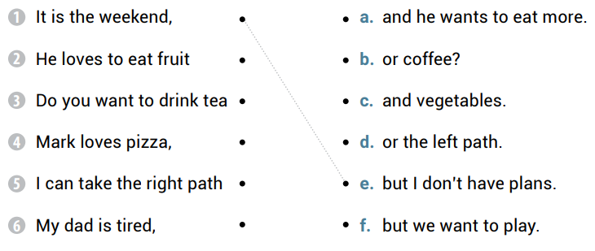

Slide 80
He loves to eat fruit and vegetables.
Do you want to drink tea or coffee?
Mark loves pizza, and he wants to eat more.
I can take the right path or the left path.
My dad is tired, but we want to play.

Slide 81
and
or
but
or

Slide 82
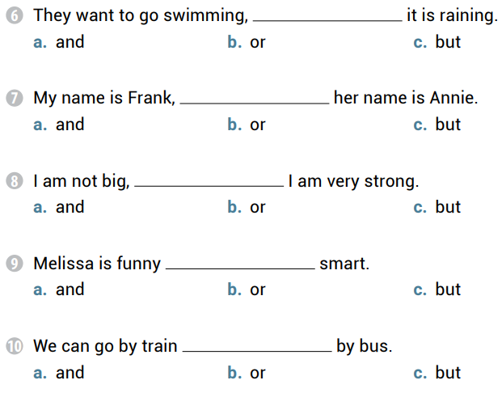
but
and
but
and
or

Slide 83
Do you want pasta or rice
The game is hard but fun
Math is boring, but I like it
Erin will clean her room or go shopping

Slide 84
or
and
and
or
but
and

Slide 85
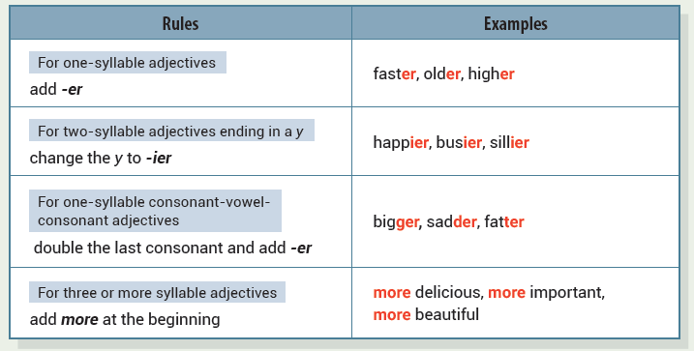
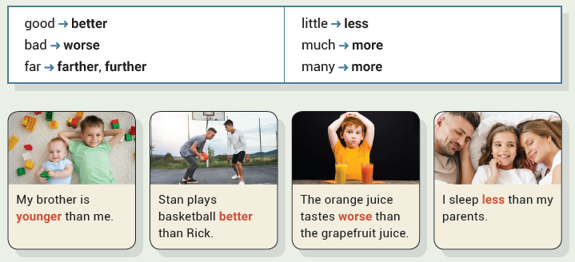
Unit 9 I Sleep Less Than My Parents
UNIT OBJECTIVE: You will be able to use regular and irregular comparative adjectives.

Slide 90
greater
more
more interesting
better
angrier
less

Slide 91
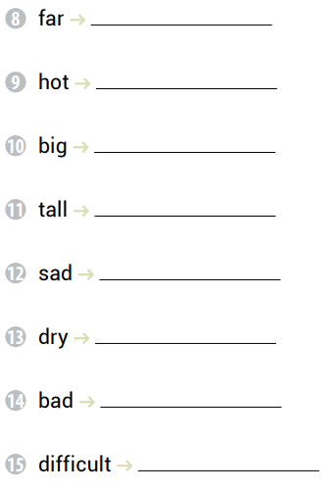
farther, further
hotter
bigger
taller
sadder
drier
worse
more difficult

Slide 92
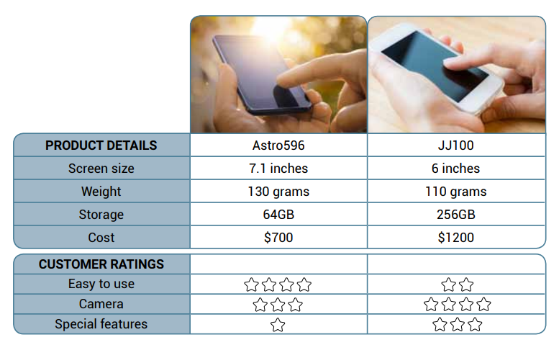
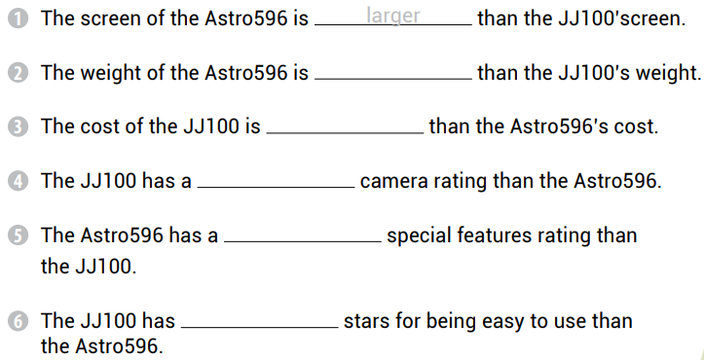
heavier
more expensive
better
worse
fewer

Slide 93
My brother is a worse student than me.
Books are more useful than TV.
Tina is a better athlete than Ryan.
An elephant is heavier than a lion.

Slide 94
closer
better
worse
more expensive
smaller

Slide 95
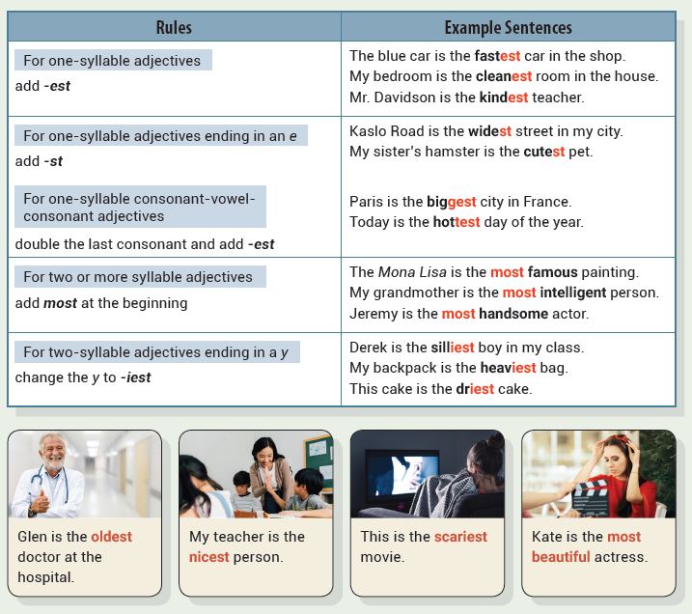
Unit 10 Paris Is the Biggest City in France
UNIT OBJECTIVE: You will be able to use superlative adjective.

Slide 98
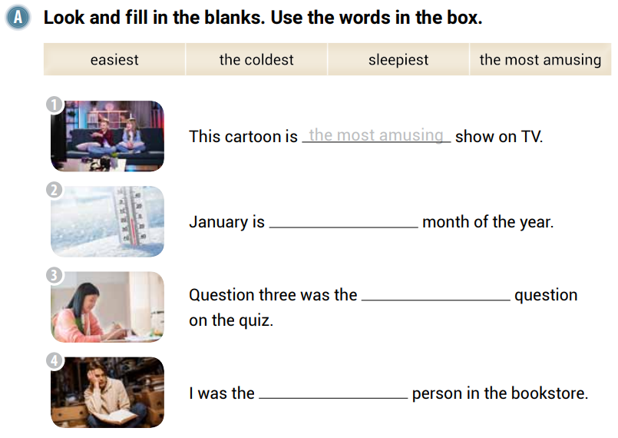
the coldest
easiest
sleepiest

Slide 100
nicest
most expensive
kindest
happiest
quietest
most interesting

Slide 101
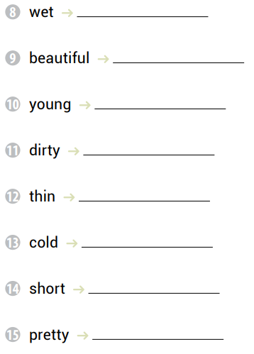
wettest
most beautiful
youngest
dirtiest
thinnest
coldest
shortest
prettiest

Slide 102
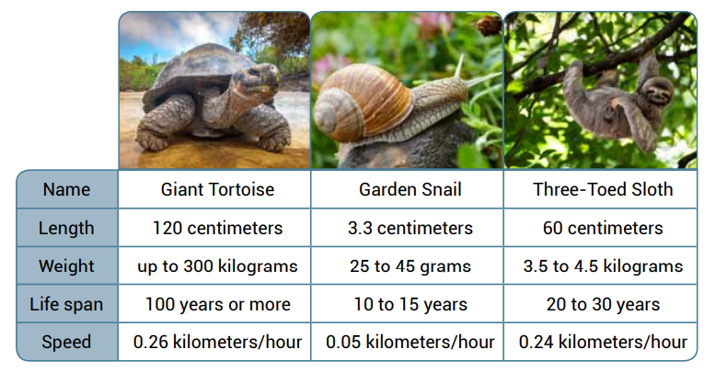
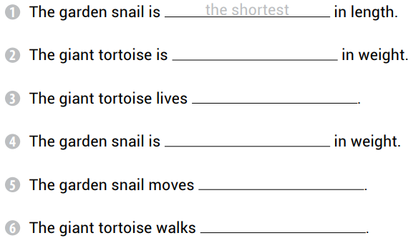
the heaviest
the longest
the lightest
the slowest
the fastest

Slide 103
the most comfortable
the hottest
the largest
the most difficult

