Slide 2
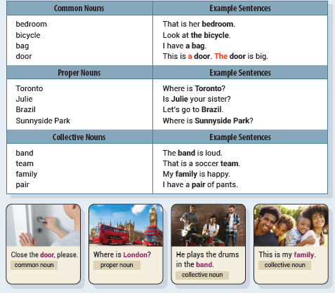
Unit 1 Look at the Bicycle
UNIT OBJECTIVE: You will be able to use common nouns, proper nouns, collective nouns, and articles.

Slide 6
collective
proper
common
proper

Slide 7
France
band
family
boots

Slide 8
pair
July
jacket
apples
a headache

Slide 9
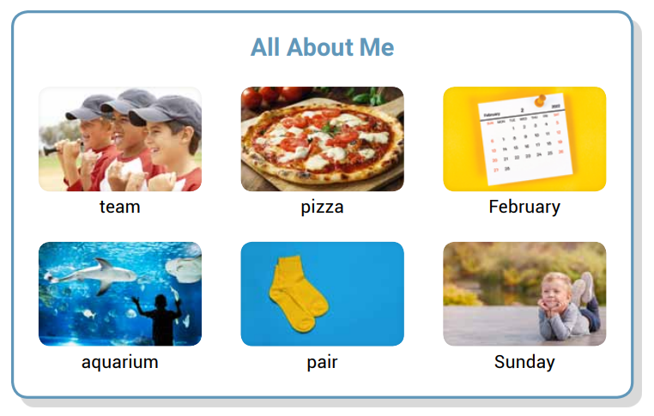
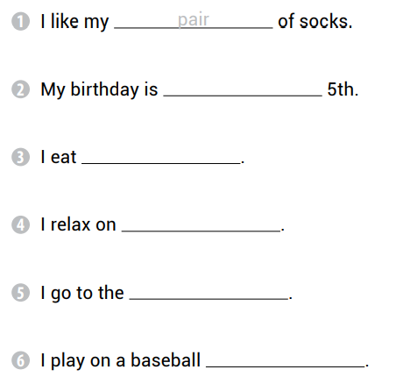
February
pizza
Sunday
aquarium
team

Slide 10
X
the
the
X

Slide 12
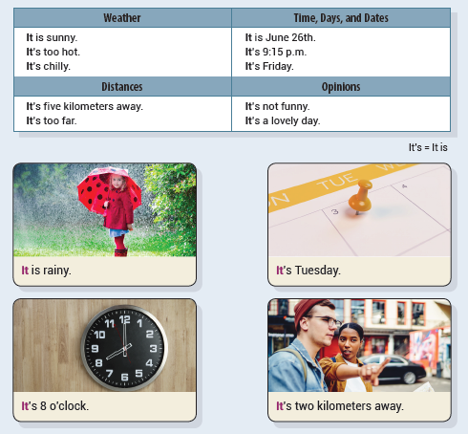
Unit 2 It Is Rainy
UNIT OBJECTIVE: You will be able to use the empty it in sentences.

Slide 13
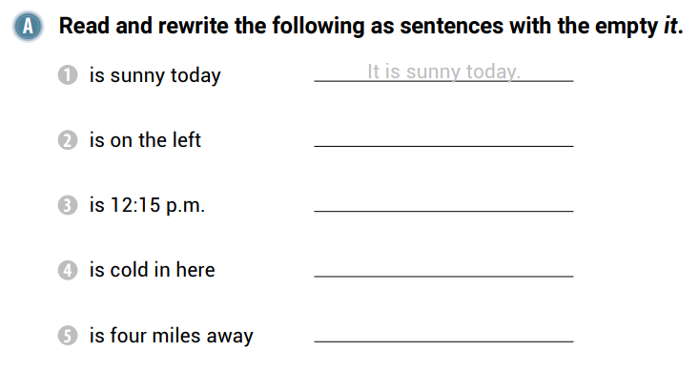
It is on the left.
It is 12:15 p.m.
It is cold in here.
It is four miles away.

Slide 14
V
V

Slide 15
It is 5 o’clock.
It is noisy.
It is morning.
It is April.

Slide 17
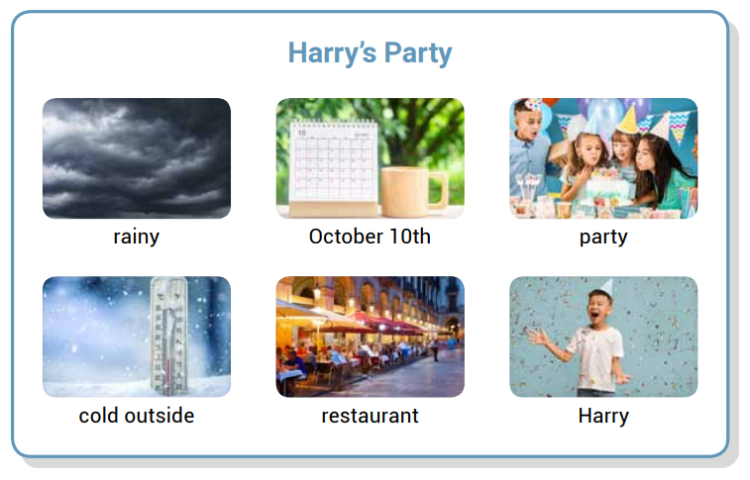
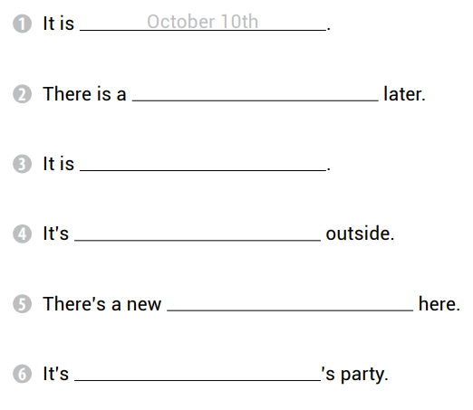
party
rainy
cold
restaurant
Harry

Slide 18
It is
It is
There is
It is
It is
It is

Slide 19
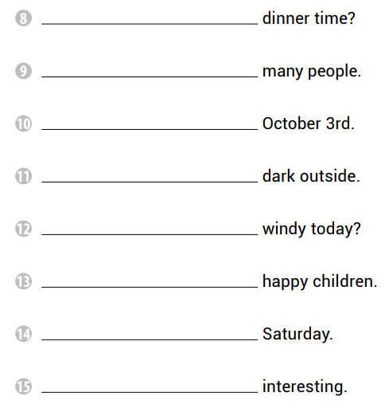
Is it
There are
It is
It is
Is it
There are
It is
It is

Slide 20
Is it Wednesday today
There are two cars
It is funny
It is lunchtime

Slide 21
It is cold.
It is windy.
It is snowy.
It is rainy.
It is cloudy.
It is hot.

Slide 22
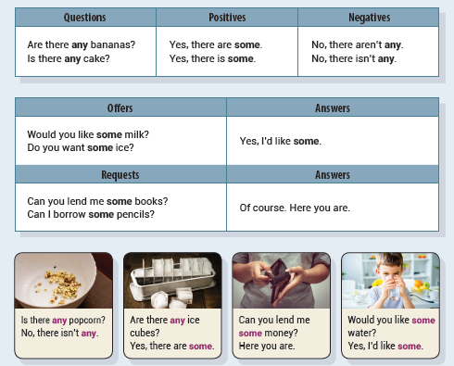
Unit 3 Are There Any Ice Cubes?
UNIT OBJECTIVE: You will be able to use some and any to talk about quantities.

Slide 24
some
any
any

Slide 25
Robert doesn’t eat any candy.
They aren’t playing any games.
She doesn’t have any homework.
Mom doesn’t buy any books.

Slide 26
Does Robert eat any candy
Are they playing any games
Does she have any homework
Does Mom buy any books

Slide 27
any
some
any
some

Slide 28
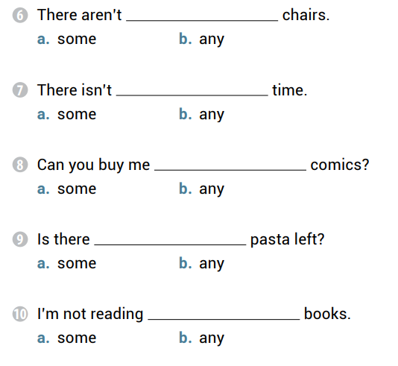
any
any
some
any
any

Slide 29
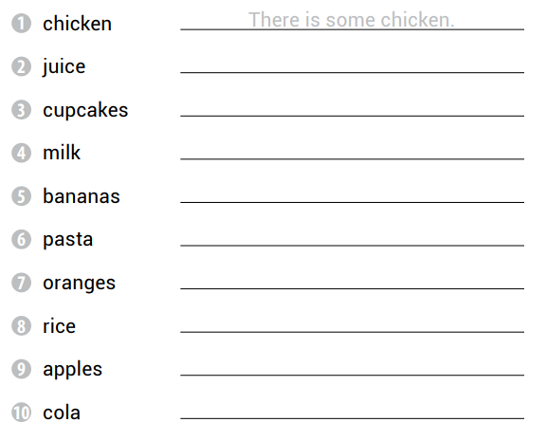
There is some juice.
There are some cupcakes.
There isn’t any milk.
There are some bananas.
There isn’t any pasta.
There are some oranges.
There is some rice.
There aren’t any apples.
There is some cola.

Slide 30
Is there any shampoo
Rita doesn’t have any pets
Would you like some rice
I want some cupcakes

Slide 32
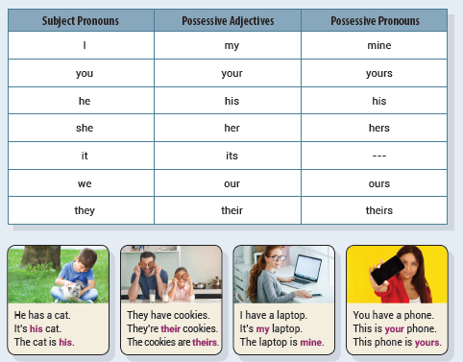
Unit 4 The Laptop Is Mine
UNIT OBJECTIVE: You will be able to use possessive adjective and pronouns.

Slide 34
mine
ours
yours

Slide 35
house is hers
That backpack is yours
These lockers are ours
This shoe is his

Slide 36
yours
my
your

Slide 37
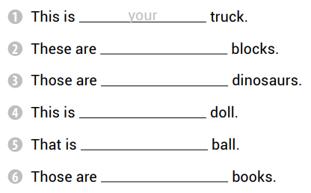
my
our
my
your
our

Slide 38
his
my
his
mine

Slide 39
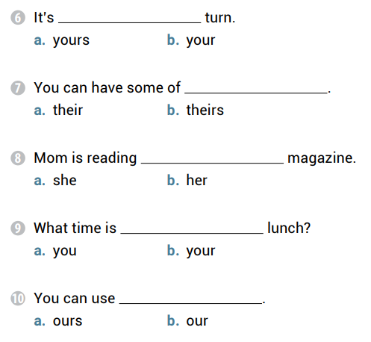
your
theirs
her
your
ours

Slide 40
That is your backpack
Is this her sandwich
I can use yours
He plays with his sister

Slide 42
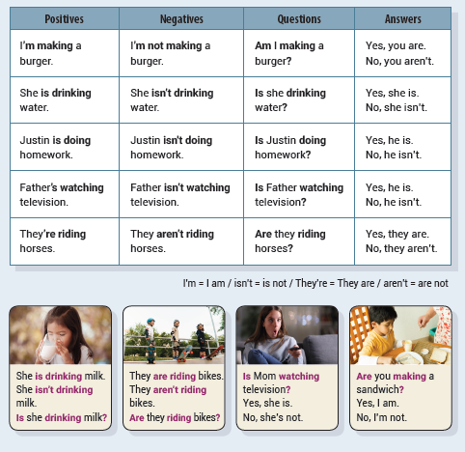
Unit 5 They Aren’t Riding Bikes
UNIT OBJECTIVE: You will be able to use the present continuous tense in positives, negatives, and questions.

Slide 44
are eating
is flying
is skating

Slide 45
am not playing
are running
is talking
Is not listening

Slide 46
Is she working
Are they taking a photo
Is she painting a picture

Slide 47
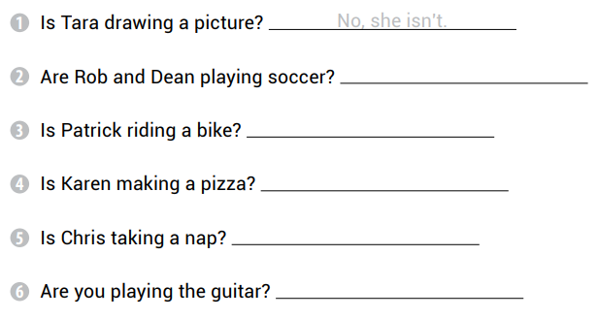
Yes, they are.
No, he isn’t.
No, she isn’t.
Yes, he is.
No, I’m not.

Slide 48
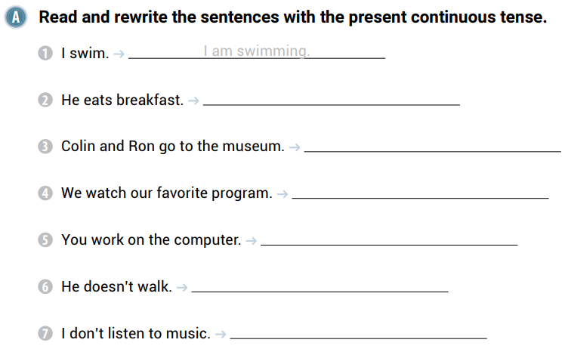
He is eating breakfast.
Colin and Ron are going to the museum.
We are watching our favorite program.
You are working on the computer.
He isn’t walking.
I’m not listening to music.

Slide 49
Mom isn’t singing.
They aren’t sleeping.
Susan isn’t jogging.
Is he drinking milk?
Are they riding the bus?
Is she playing basketball?
Are you writing poems?
Are Polly and Donna going to the library?

Slide 50
Is Susan writing in a diary
Are Jules and Julia riding the bus
Is Mike feeding the cat
Are you making a sandwich

Slide 52
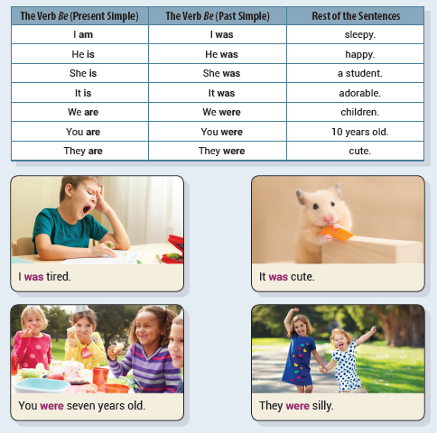
Unit 6 I Was Tired
UNIT OBJECTIVE: You will be able to use the past simple tense with the verb be.

Slide 55
were
were
was
was

Slide 56
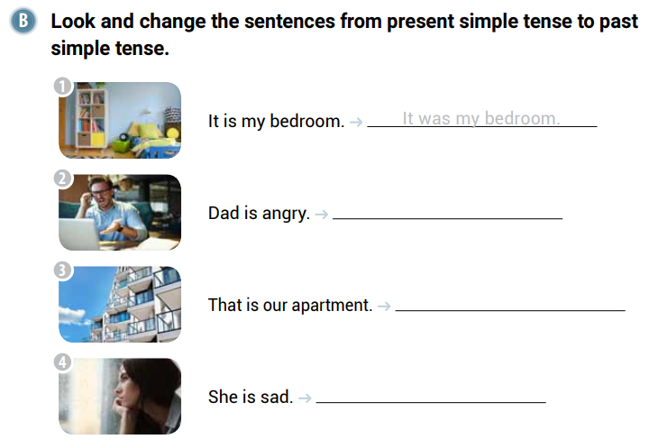
Dad was angry.
That was our apartment.
She was sad.

Slide 57
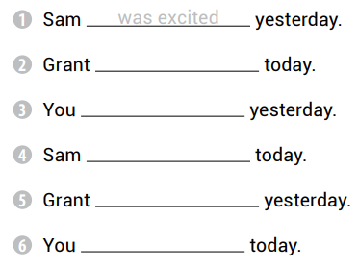
is happy
were angry
is surprised
was sad
are silly

Slide 58
Mom was outside.
The girls were bored.
That movie was boring.
Those were his snacks.
My friends were at school.
It was her parents’ anniversary.

Slide 59
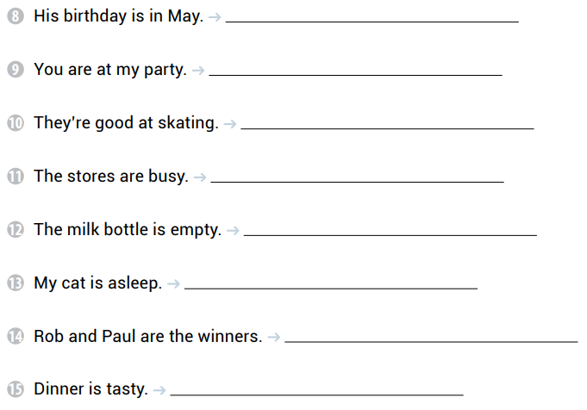
His birthday was in May.
You were at my party.
They were good at skating.
The stores were busy.
The milk bottle was empty.
My cat was asleep.
Rob and Paul were the winners.
Dinner was tasty.

Slide 60
Steve and Sally were confused
They were my ideas
I was your waiter
They were his and hers

Slide 61
was
were
were
was
was
was
was
was
were

Slide 62
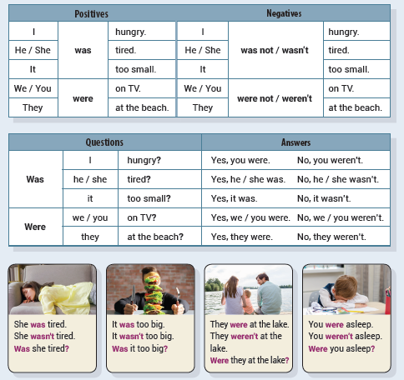
Unit 7 They Weren’t at the Lake
UNIT OBJECTIVE: You will be able to use the past simple tense be in negatives and questions.

Slide 64
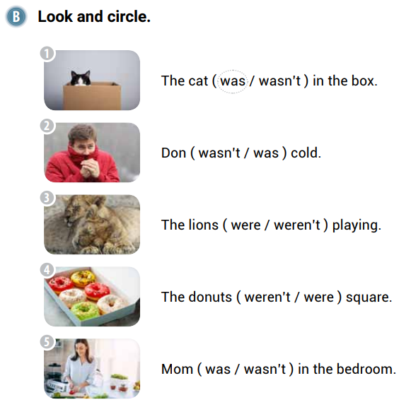

Slide 65
Were they in the shopping mall
Was that a good day
Were her cousins upset
Were the children at the beach

Slide 66
No, they weren’t.
Yes, she was.
Yes, it was.
Yes, it was.

Slide 67
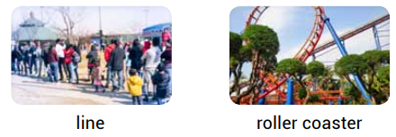
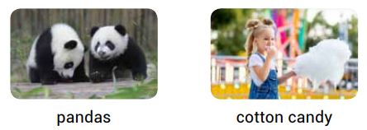
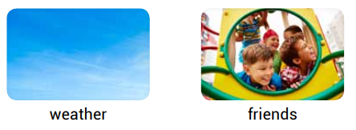
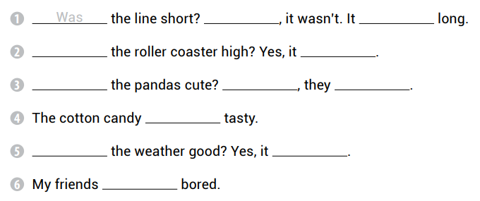
No
was
Was
was
Were
Yes
were
was
Was
was
weren’t

Slide 68
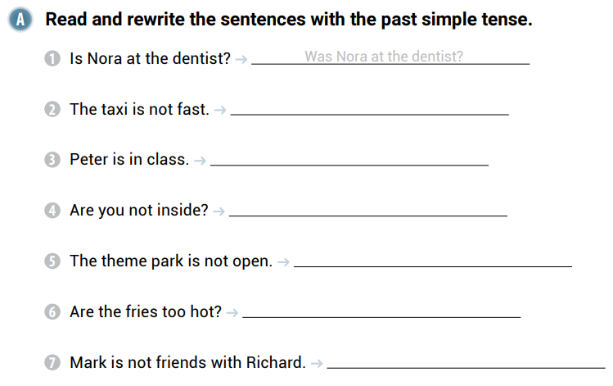
The taxi was not fast.
Peter was in class.
Were you not inside?
The theme park was not open.
Were the fries too hot?
Mark was not friends with Richard.

Slide 69
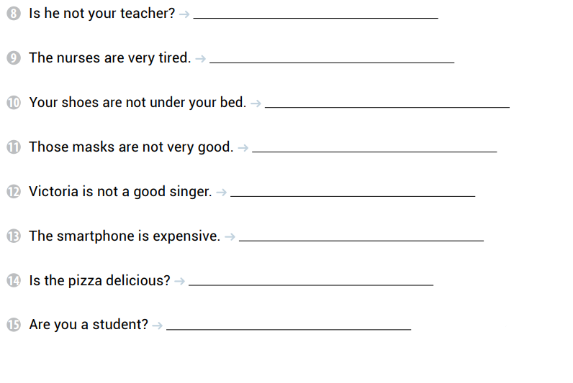
Was he not your teacher?
The nurses were very tired.
Your shoes were not under your bed.
Those masks were not very good.
Victoria was not a good singer.
The smartphone was not expensive.
Was the pizza delicious?
Were you a student?

Slide 70
Were you good at volleyball
Clara was late for the party
The math test wasn’t difficult
Was Cindy upset with me

Slide 71
wasn’t
Was
No
Were
weren’t
were
was
weren’t

Slide 72
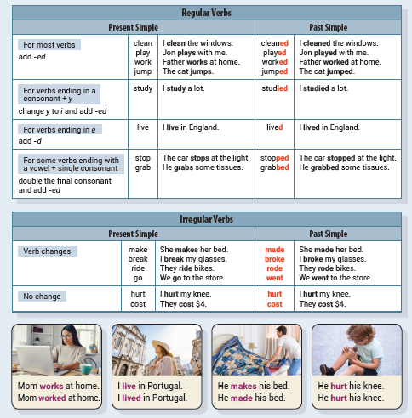
Unit 8 He Made His Bed
UNIT OBJECTIVE: You will be able to use the past simple tense with regular and irregular verbs.

Slide 75
studied
went
made
cost

Slide 76
studied
made
jumped

Slide 77
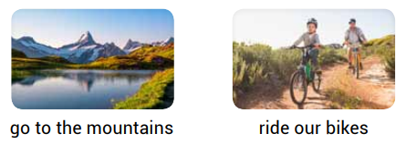
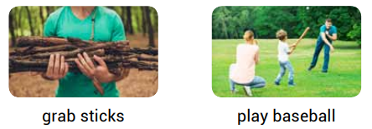
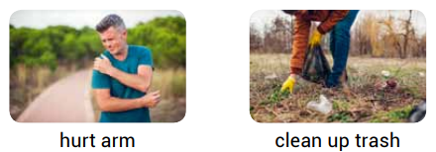
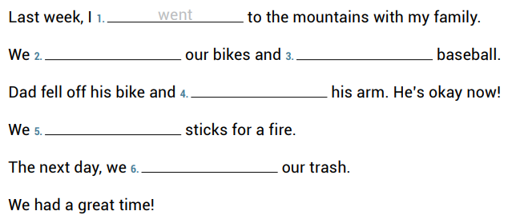
rode
played
hurt
grabbed
cleaned up

Slide 78
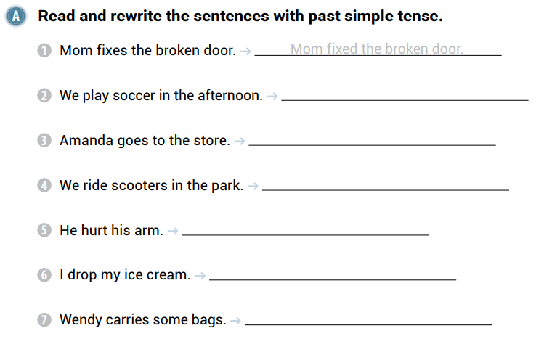
We played soccer in the afternoon.
Amanda went to the store.
We rode scooters in the park.
He hurt his arm.
I dropped my ice cream.
Wendy carried some bags.

Slide 79
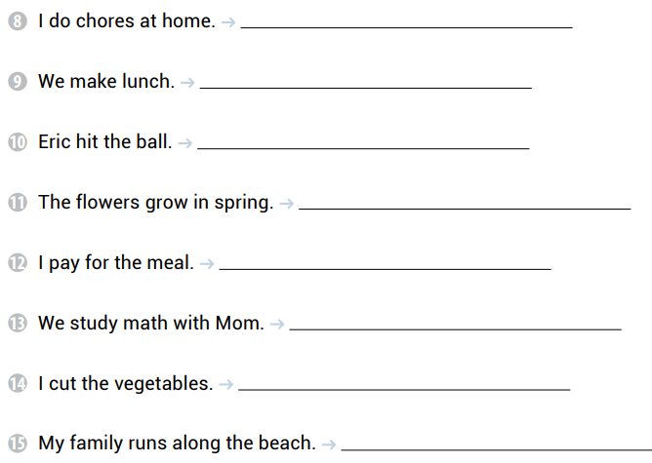
I did chores at home.
We made lunch.
Eric hit the ball.
The flowers grew in spring.
I paid for the meal.
We studied math with Mom.
I cut the vegetables.
My family ran along the beach.

Slide 80
We ate our dinner
They rode the bus
Terry played video games
My sister made pancakes

Slide 81
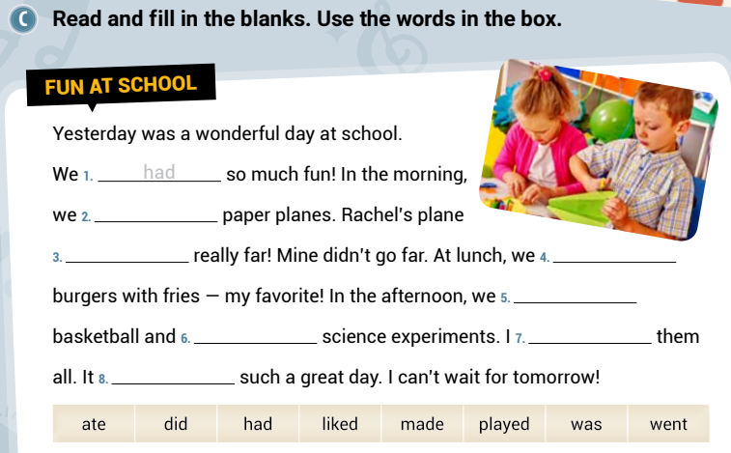
made
went
ate
played
did
liked
was

Slide 82
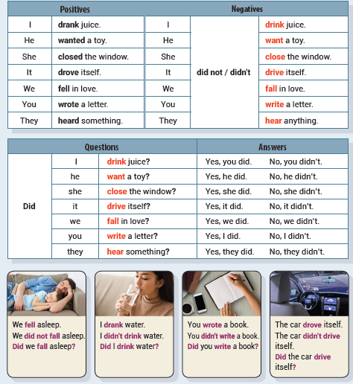
Unit 9 Did She Close the Window?
UNIT OBJECTIVE: You will be able to use the past simple tense in negatives and questions.

Slide 85
Terry didn’t want to buy a new bag.
We didn’t drive to the beach on the weekend.
Donna didn’t fall off her bike.
Polly didn’t close the door.

Slide 86
No, he didn’t.
Yes, he did.
No, they didn’t.
No, it didn’t.

Slide 87
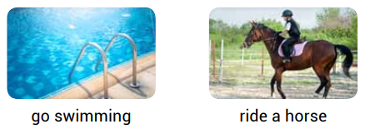
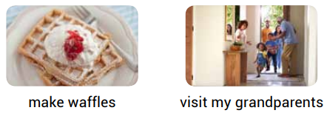
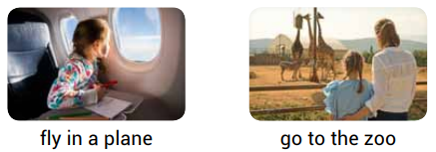
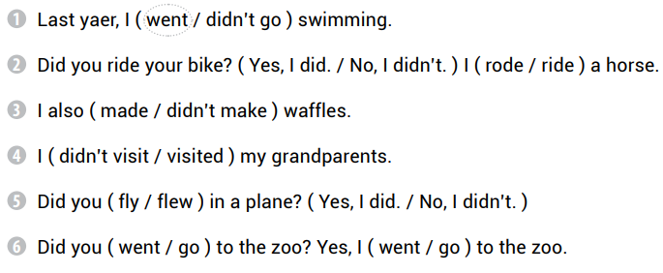

Slide 88
go
watch
Did she
read

Slide 89
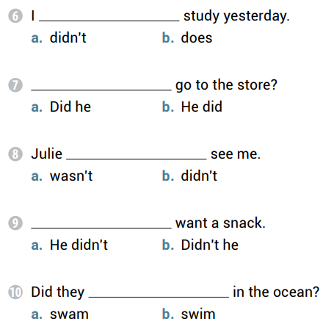
didn’t
Did he
didn’t
He didn’t
swim

Slide 90
Did Andy walk home
Did she sing loud
The birds didn’t fly high
You didn’t open the door

Slide 91
have
had
good
come
Yes
like
didn’t

Slide 92
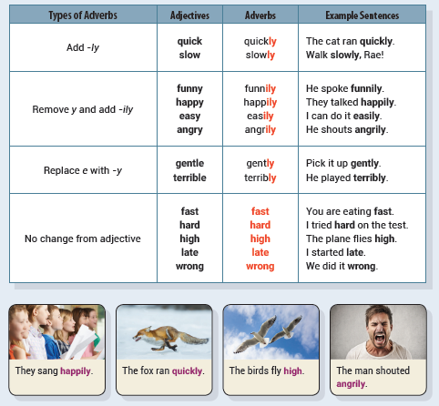
Unit 10 They Sang Happily
UNIT OBJECTIVE: You will be able to use adverbs.

Slide 95
quickly
slowly
well
wrong

Slide 96
fast
funnily
slowly
gently

Slide 97
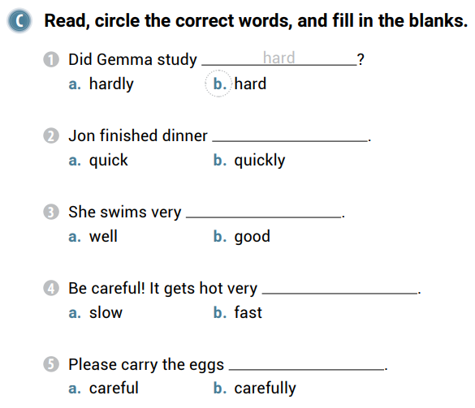
quickly
well
fast
carefully

Slide 98
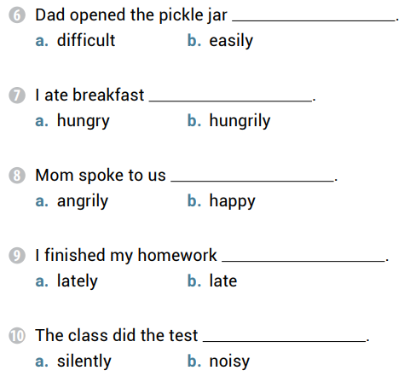
easily
hungrily
angrily
late
silently

Slide 99
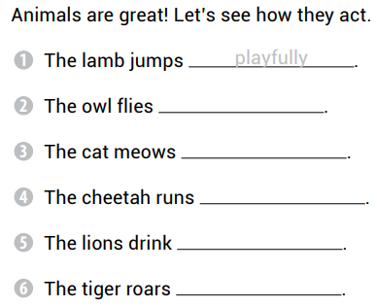
silently
loudly
fast
thirstily
scarily

Slide 100
It rained hard yesterday
Dad speaks loudly
Didn’t you study hard
They are drinking thirstily

Slide 101
happily
late
quickly
well
badly
terribly

