Slide 2
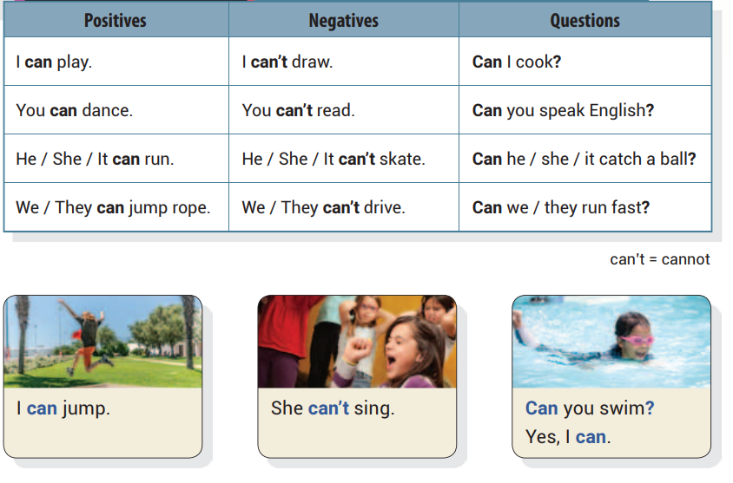
Unit 1 He Can Ride a Bike
UNIT OBJECTIVE: You will be able to use can and can’t in statements and questions.

Slide 4
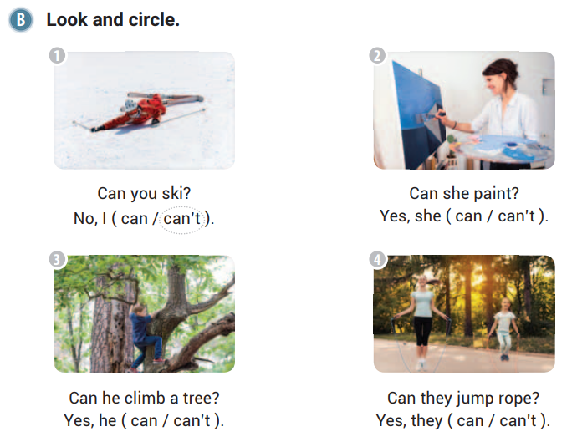

Slide 5
can
can
can’t

Slide 7
Can
they
can
Can
I
can
he
can’t
Can
she
can

Slide 8
They can’t skateboard
You can’t speak Chinese
He can make a sandwich

Slide 9
Can she speak Spanish
Can I fly a plane

Slide 10
Can we fly a kite
Can it catch fish
Can they do ballet

Slide 11
can’t
Can
can’t
can
can

Slide 12
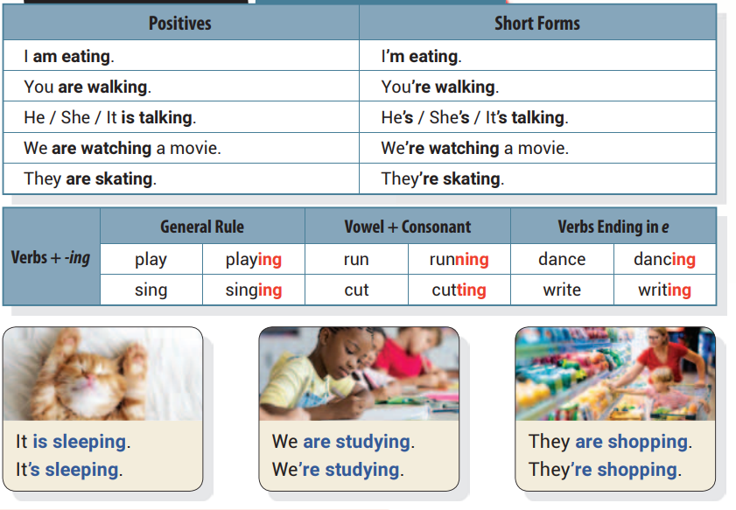
Unit 2 He Is Juggling
UNIT OBJECTIVE: You will be able to use the present continuous tense.

Slide 13
writing
smiling
watching
swimming
raining

Slide 14
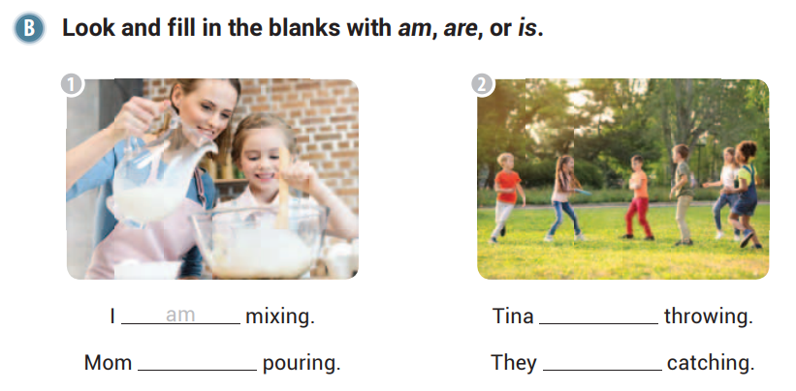
is
is
are

Slide 16
are
drinking
is
cleaning
are
playing

Slide 17
I’m
Anne’s
They’re

Slide 18
He is throwing a ball.
We are reading.
It is swimming.

Slide 19
I am digging a hole.
We are making lunch.

Slide 20
They are playing football.
Alex is fishing.
We are going to school.

Slide 21
am
are
are
is
are

Slide 22
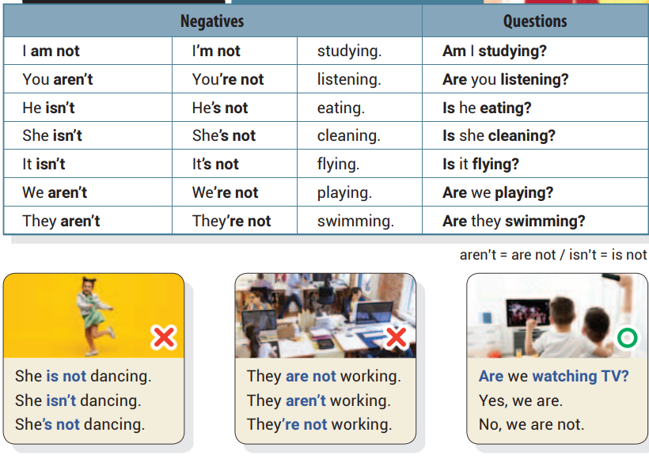
Unit 3 Is Anne Skiing?
UNIT OBJECTIVE: You will be able to use the present continuous tense in negatives and questions.

Slide 24
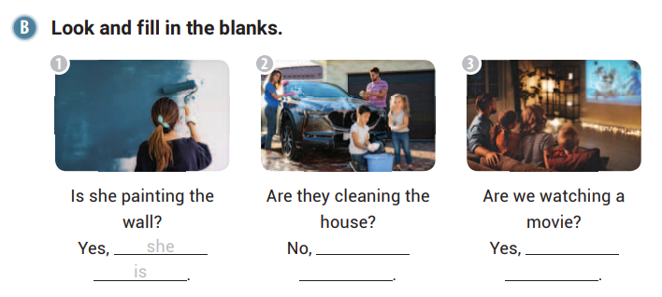
they
we
aren’t
are

Slide 26
No, they aren’t.
Yes, I am.
No, she isn’t.

Slide 27
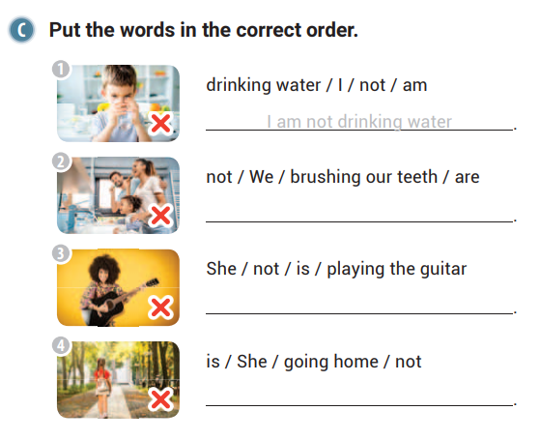
We are not brushing our teeth
She is not playing the guitar
She is not going home

Slide 28
Are you going to school?
The baby is not taking a nap.
Are you dancing?

Slide 29
She is not mopping the floor.
You are not setting the table.

Slide 30
They are not getting on the bus.
You are not doing the laundry.
It is not eating.

Slide 31
I’m
not
Are
I’m
not
Is
She
isn’t

Slide 32
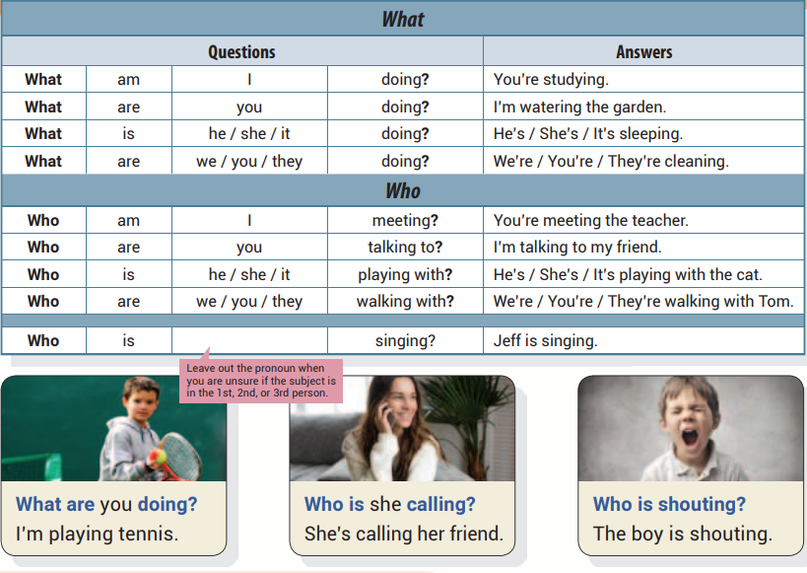
Unit 4 What Are You Doing?
UNIT OBJECTIVE: You will be able to use the words who and what in questions along with the present continuous tense.

Slide 33
Who
Who
What

Slide 35
jumping
reading
juggling

Slide 36
Who
is
What
is
he

Slide 37
What
He
is
What
They
are
Who
She
is

Slide 38
Who is meeting us at the park
Who is crying
Who is dancing with Jake

Slide 39
What is she eating
What are they wearing

Slide 40
What are you playing
What is he making
What is it carrying

Slide 41
am
What
They’re
Who
is

Slide 42
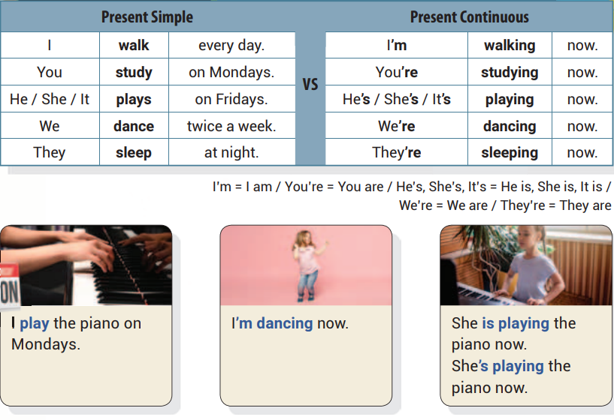
Unit 5 I Play Soccer Every Day
UNIT OBJECTIVE: You will learn the difference between the present simple
tense and the present continuous tense.

Slide 44
fish
rollerblading
camping

Slide 46
eating
taking
moving

Slide 48
She walks to school at 8:00 a.m.
They skate twice a week.
I am brushing the cat.

Slide 49
I am collecting rocks.
Mom is reading the newspaper.

Slide 50
We are folding the laundry.
Dad is exercising.
I am making a card.

Slide 51
coming
riding
get
up
eat
swim
sing
build

Slide 52
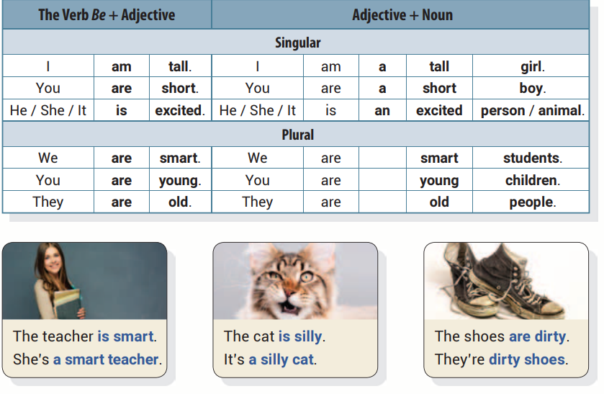
Unit 6 My Mother Is Kind
UNIT OBJECTIVE: You will learn how to use adjectives in statements.

Slide 54
bird
cat
black
cute

Slide 56
smart
big
scary

Slide 57
cat
man
fat
new
children
car
short

Slide 58
She is talented
It’s a purple sofa
The students are bored

Slide 59
a beautiful lake
hot cookies

Slide 60
green leaves
an old woman
black cats

Slide 62
Unit 7 The Taxi Is Faster
UNIT OBJECTIVE: You will be able to use comparatives.

Slide 63
taller
older
skinnier
dirtier

Slide 64
more
cuter
difficult

Slide 65
She
He
They

Slide 67
darker
more
expensive
sillier

Slide 68
Her students are not quieter.
A hammer is not more useful.
Bears are not lighter than elephants.

Slide 69
Apples are harder than oranges.
Art is easier than math.

Slide 70
Her hair is longer than her friend’s hair.
Fall is cooler than summer.
Playing chess is more difficult than playing cards.

Slide 71
bigger
more
expensive
more
delicious
sweeter

Slide 72
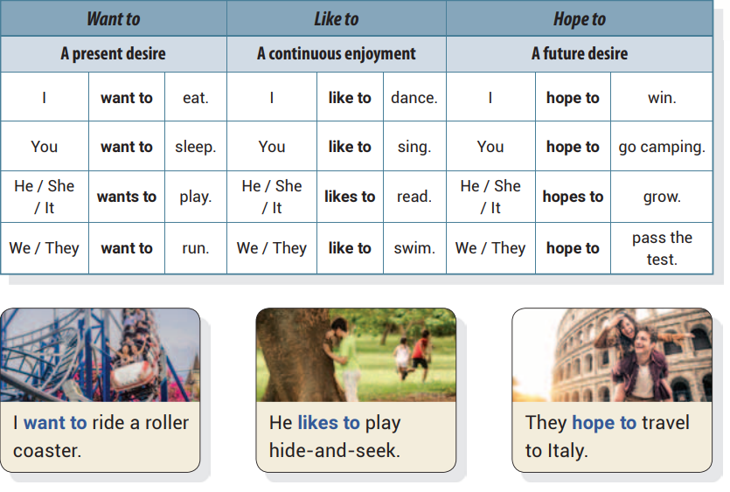
Unit 8 I Hope to Make Many Friends Here
UNIT OBJECTIVE: You will be able to use want to, like to, and hope to in
statements.

Slide 74
want
to
like
to
want
to

Slide 76
get
a
pet
watch
football
buy
new
shoes

Slide 77
hopes
to
win
first
prize
wants
to
call
her
mom
hope
to
get
many
presents

Slide 78
Pete likes to play dodgeball
Mom wants to buy apples
She hopes to become a singer

Slide 79
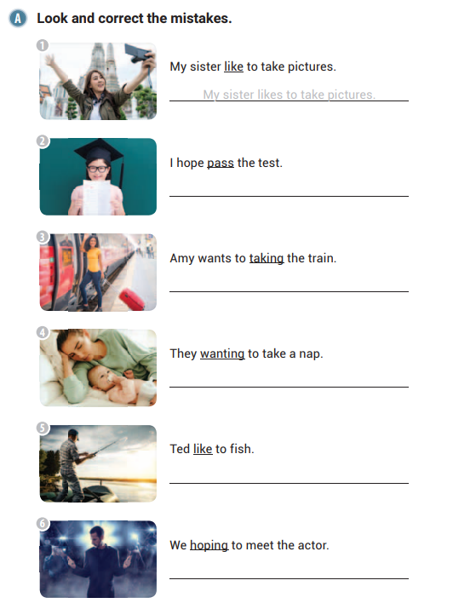
I hope to pass the test.
Amy wants to take the train.

Slide 80
They want to take a nap.
Ted likes to fish.
We hope to meet the actor.

Slide 82
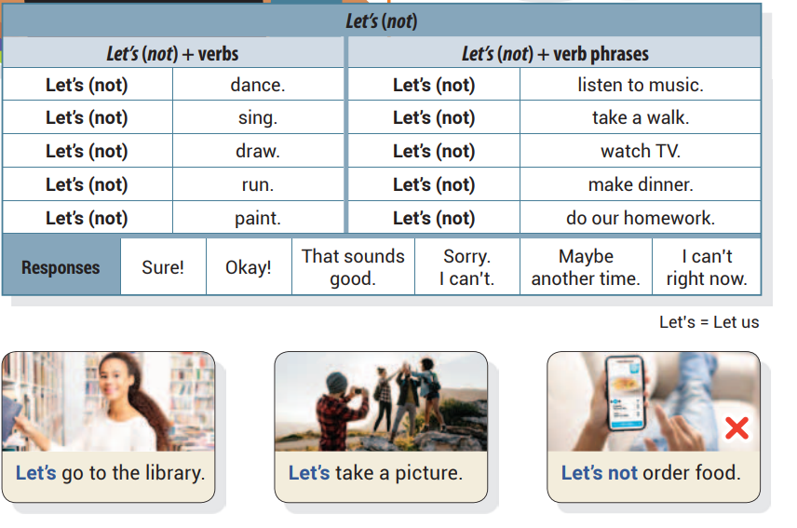
Unit 9 Let’s Wrap the Presents
UNIT OBJECTIVE: You will learn how to use let’s to make suggestions.

Slide 84
Let’s
jog
eat
cake

Slide 86
not
close
the
windows
have
a
feed
the
picnic
fish

Slide 87
That sounds good.
Maybe another time.
Maybe another time.

Slide 88
Let’s go to the museum.
Let’s have a party.
Let’s walk to school.

Slide 89
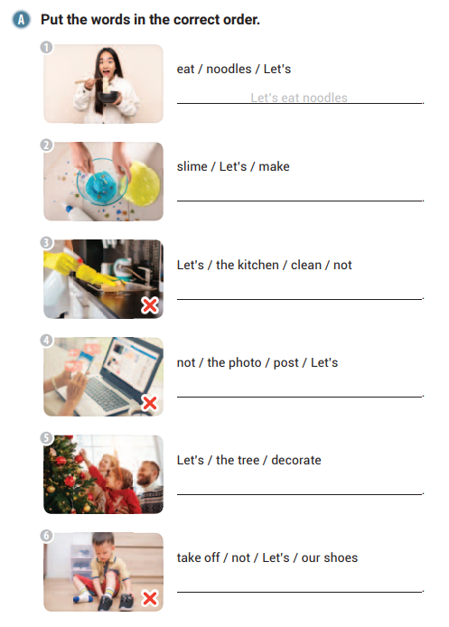
Let’s make slime
Let’s not clean the kitchen

Slide 90
Let’s not post the photo
Let’s decorate the tree
Let’s not take off our shoes

Slide 92
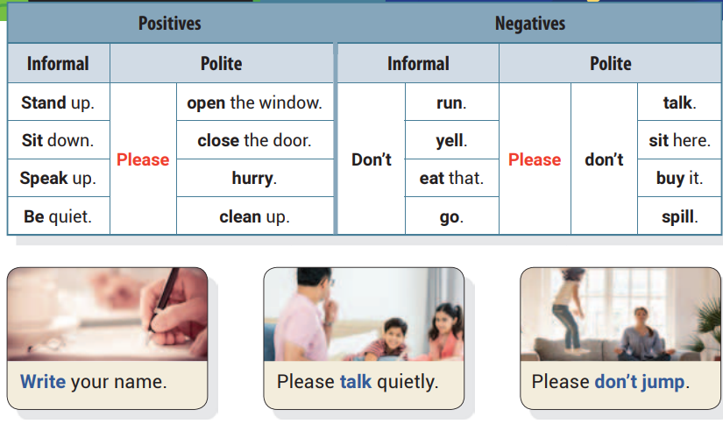
Unit 10 Please Stay in Your Seat
UNIT OBJECTIVE: You will be able to use imperative statements.

Slide 94
stand
up
don’t
open
the
don’t
stand
up
door

Slide 96
eat
the
cake
feed
the
sing
cat

Slide 98
Please don’t make a mess.
Please brush your hair.
Please turn off the music.

Slide 99
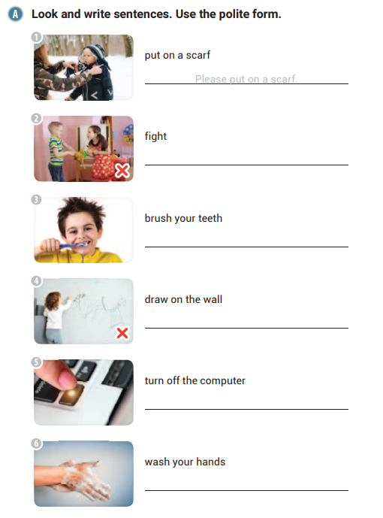
Please don’t fight.
Please brush your teeth.

Slide 100
Please don’t draw on the wall.
Please turn off the computer.
Please wash your hands.

