Slide 2
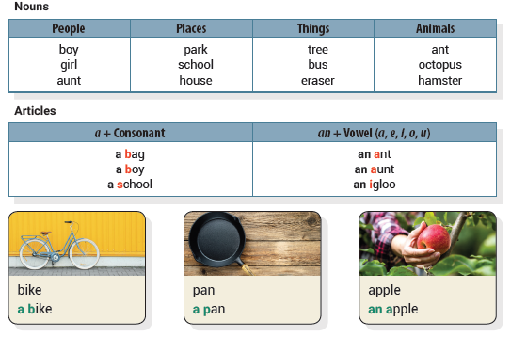
Unit 1 A Boy
UNIT OBJECTIVE: You will be able to use nouns and articles.

Slide 3
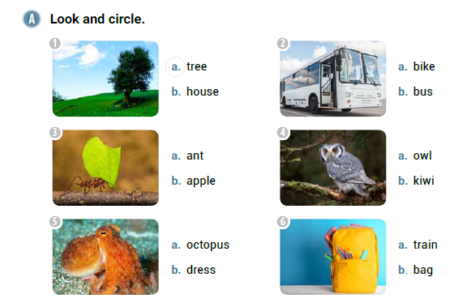

Slide 4
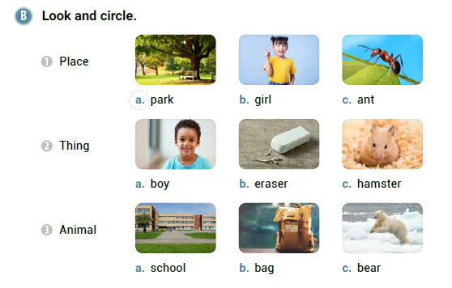

Slide 6
an
a
an

Slide 7
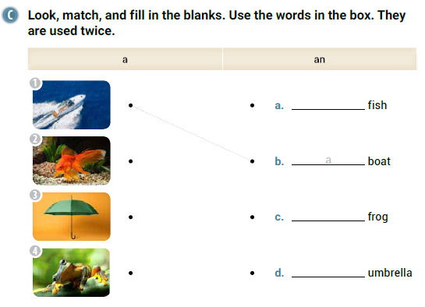
a
a
an

Slide 8
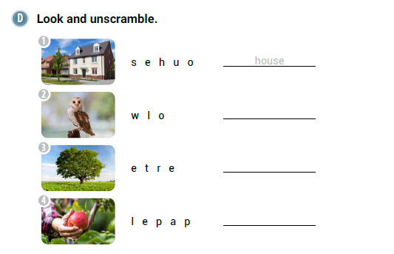
owl
tree
apple

Slide 9
a
ant

Slide 10
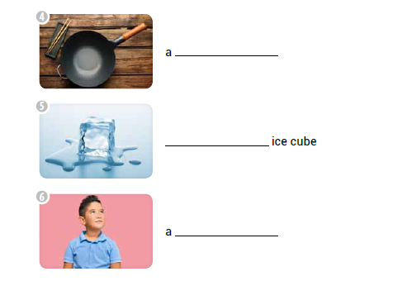
pan
an
boy

Slide 11
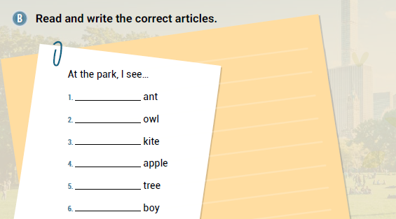
an
an
a
an
a
a

Slide 12
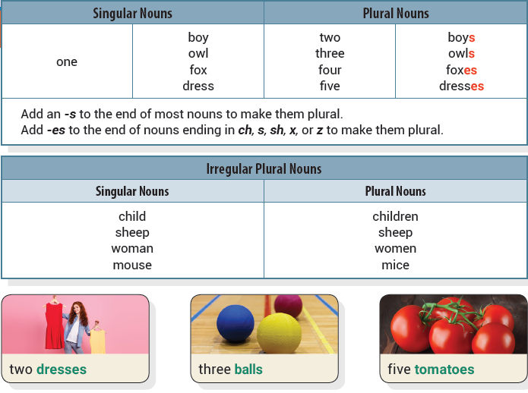
Unit 2 Three Owls
UNIT OBJECTIVE: You will be able to use singular nouns and plural nouns.

Slide 13
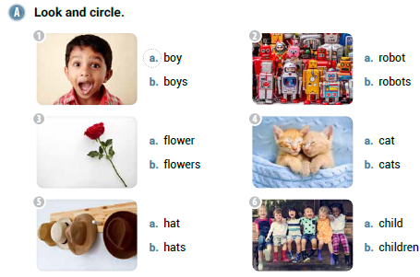

Slide 14
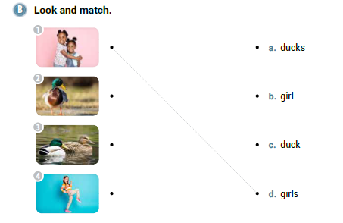

Slide 15
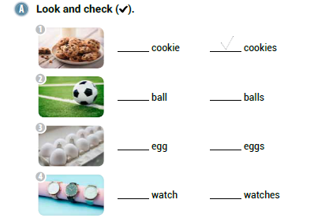

Slide 16
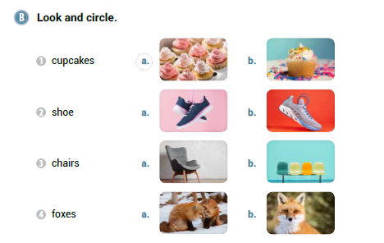

Slide 18
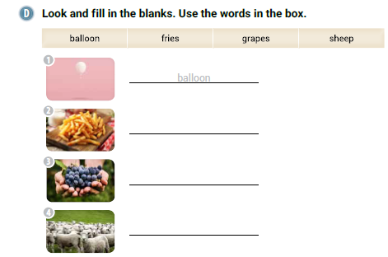
fries
grapes
sheep

Slide 19
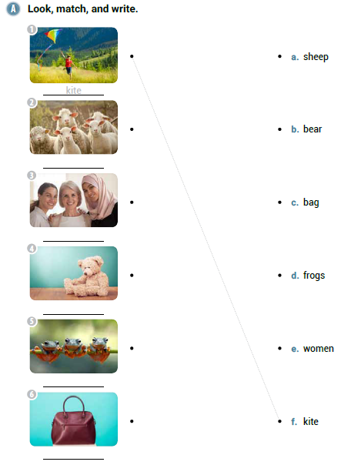
sheep
women
bear
frogs
bag

Slide 20
s
es
s
s

Slide 21
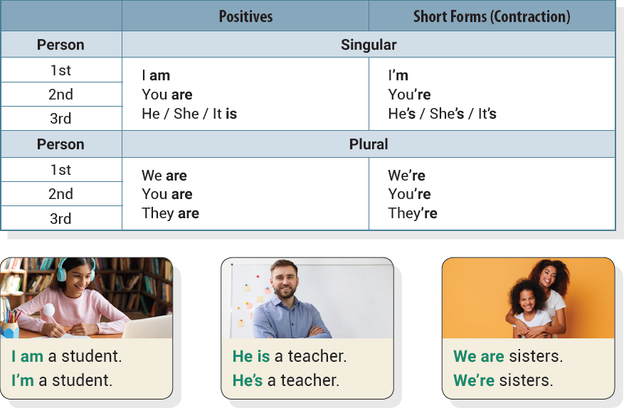
Unit 3 We Are Friends
UNIT OBJECTIVE: You will be able to use subject pronouns and the verb be.

Slide 23
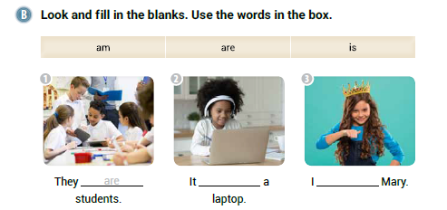
is
am

Slide 24
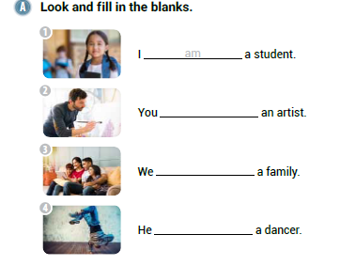
are
are
is

Slide 25
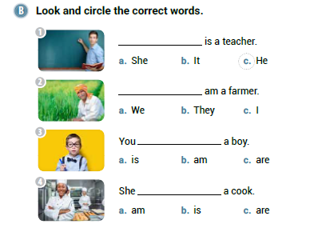

Slide 26
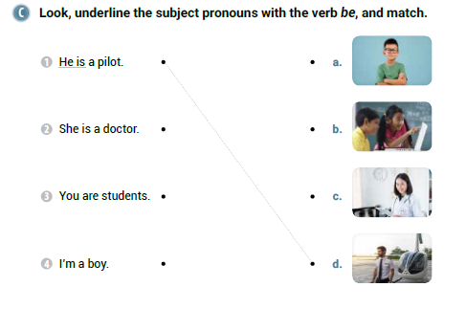

Slide 27
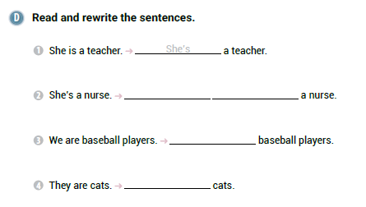
She
is
We’re
They’re

Slide 28
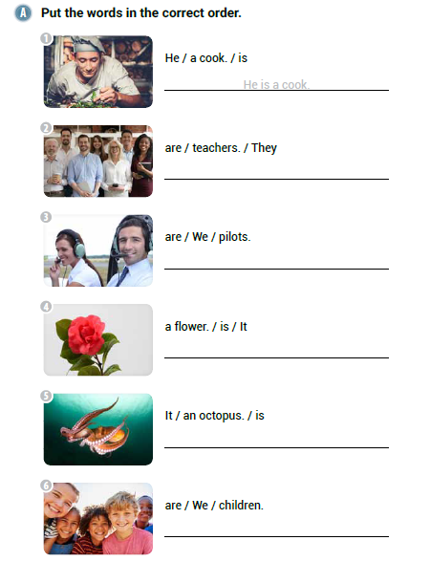
They are teachers.
We are pilots.
It is a flower.
It is an octopus.
We are children.

Slide 29
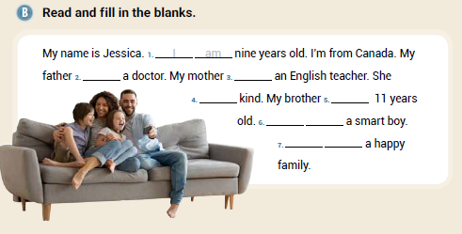
is
is
is
is
He
is
We
are

Slide 30
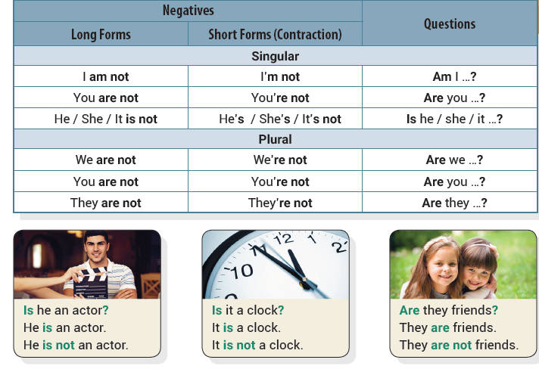
Unit 4 Are They Friends?
UNIT OBJECTIVE: You will be able to use the verb be in negatives and
questions.

Slide 31
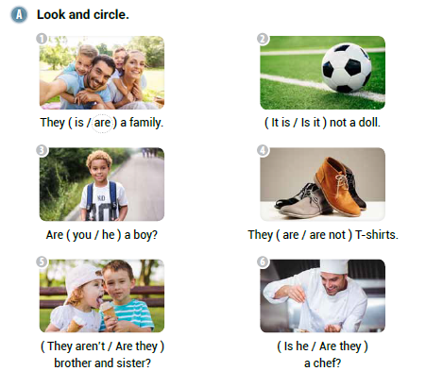

Slide 32
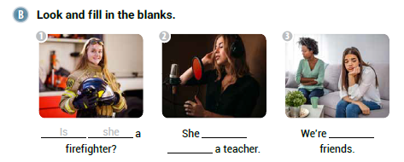
is
not
not

Slide 34
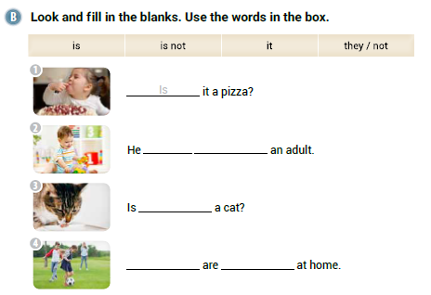
is
not
it
They
not

Slide 35
not
Are
am

Slide 36
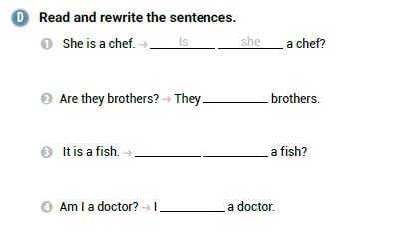
are
Is
it
am

Slide 37
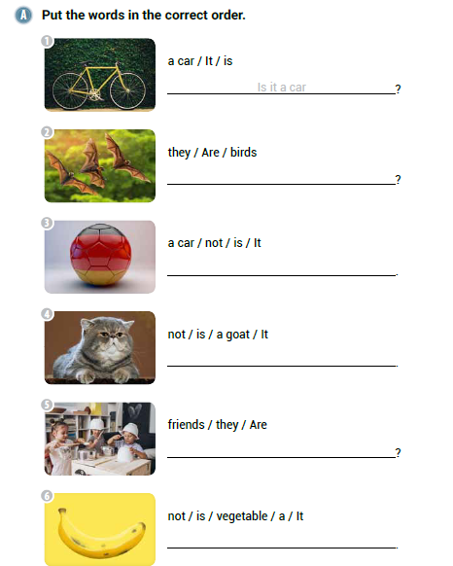
Are they birds
It is not a car
It is not a goat
Are they friends
It is not a vegetable

Slide 38
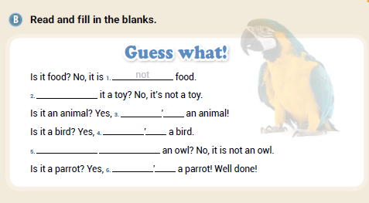
Is
It
s
It
s
Is
it
It
s

Slide 39
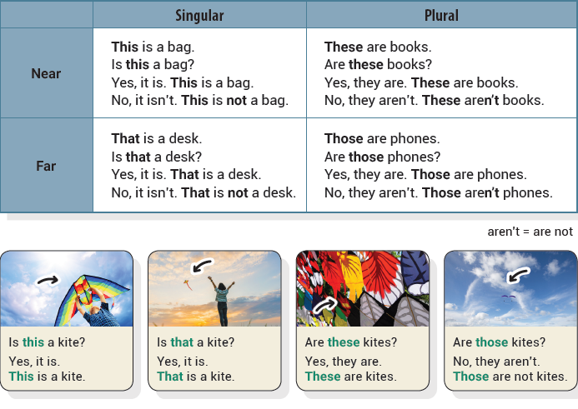
Unit 5 This Is a Pineapple
UNIT OBJECTIVE: You will be able to use demonstrative pronouns in positives, negatives, and questions.

Slide 40
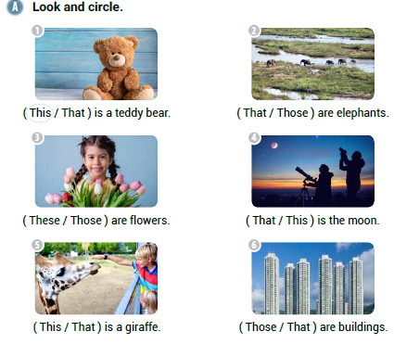

Slide 41
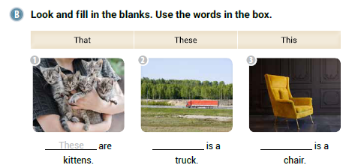
That
This

Slide 42
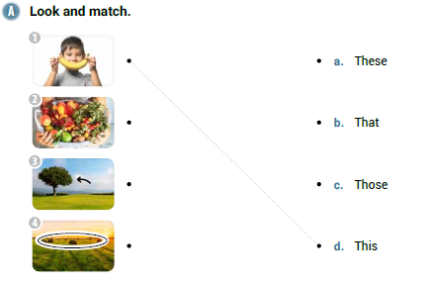

Slide 43
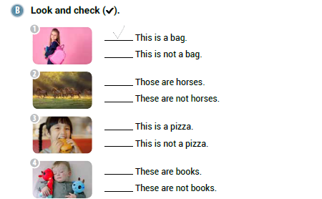

Slide 44
These
This
That

Slide 45
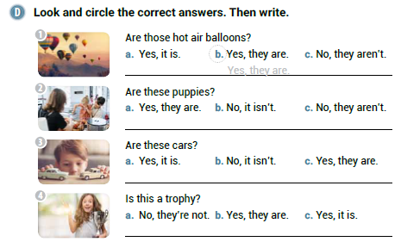
No, they aren’t.
Yes, they are.
Yes, it is.

Slide 46
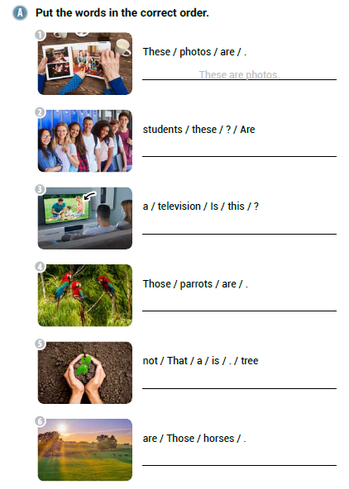
Are these students?
Is this a television?
Those are parrots.
That is not a tree.
Those are horses.

Slide 47
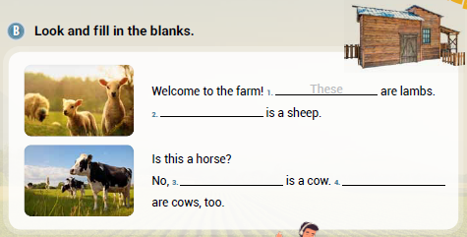
That
This
Those

Slide 48
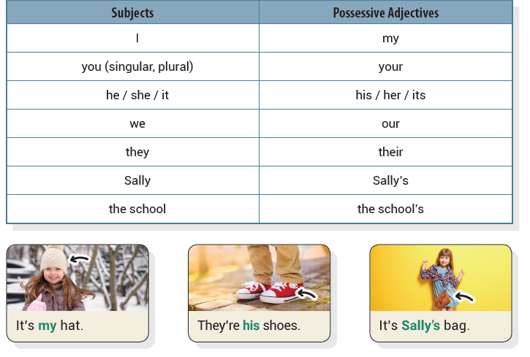
Unit 6 It’s Sally’s Hat
UNIT OBJECTIVE: You will be able to use possessives.

Slide 49
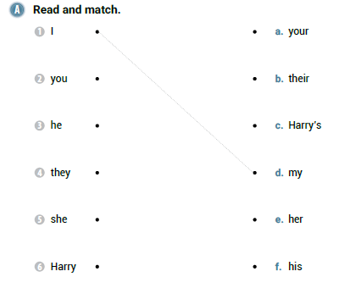

Slide 50
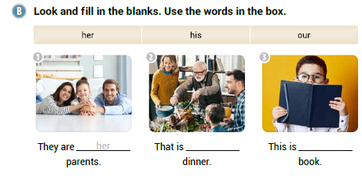
our
his

Slide 51
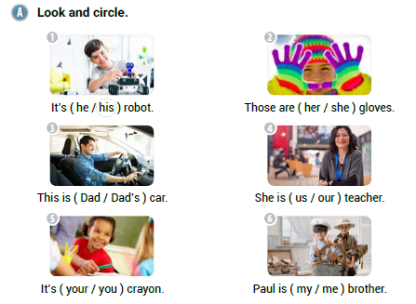

Slide 53
Paul’s
singer’s
our

Slide 54
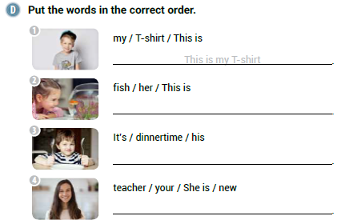
This is her fish
It’s his dinnertime
She is your new teacher

Slide 55
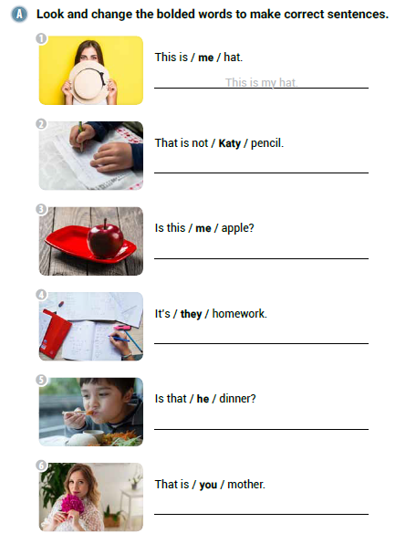
That is not Katy’s pencil.
Is this my apple?
It’s their homework.
Is that his dinner?
That is your mother.

Slide 56
Ben’s
his
Nicole’s
her
Our

Slide 57
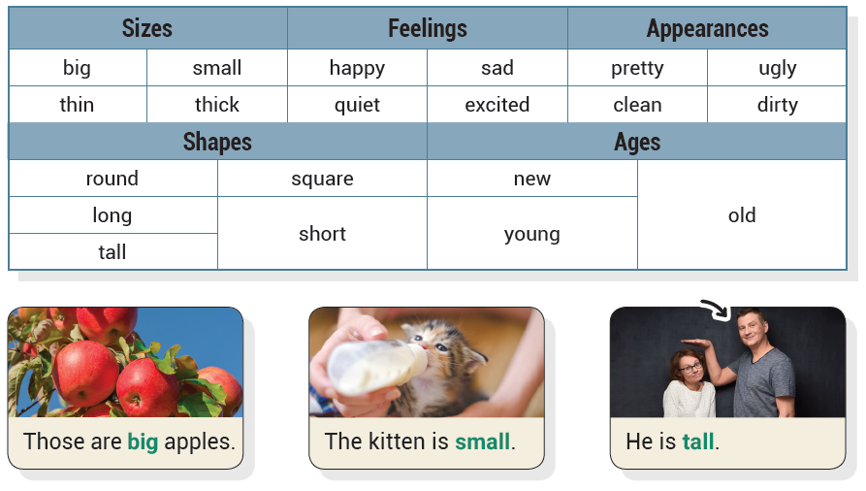
Unit 7 He Is Tall
UNIT OBJECTIVE: You will be able to use adjectives.

Slide 58
tall
big
noisy
quiet
small
short
old
new

Slide 59
happy
dirty

Slide 63
short
sad
cold

Slide 64
This is a big classroom
The boy is happy
Are they long pencils
He is not sad
My clothes are old

Slide 65
dirty
new
great
cheap
expensive
happy

Slide 66
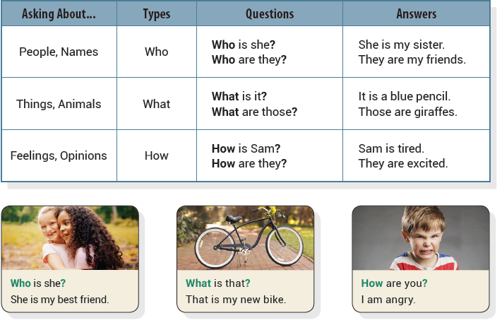
Unit 8 Who is He?
UNIT OBJECTIVE: You will be able to use information questions.

Slide 68
Who
How

Slide 70
What
Who

Slide 73
How are you
What are they
Who is she
How is her teacher
What is it

Slide 74
How
Who
What

Slide 75
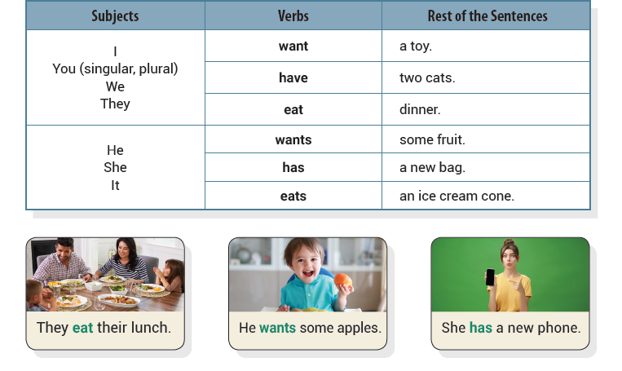
Unit 9 I Have a Yellow Banana
UNIT OBJECTIVE: You will be able to use the present simple tense.

Slide 77
wants
has

Slide 80
eats
eat
wants

Slide 81
She has long hair.
They eat breakfast.
It has short legs.

Slide 82
I have dirty hands.
She has big shoes.
Clara has a horse.
You eat a big burger.

Slide 83
wants
wants
has
has
eat

Slide 84
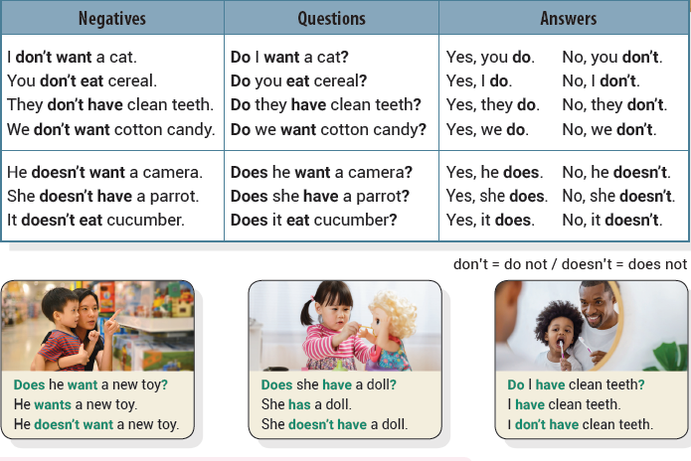
Unit 10 I Don’t Have Dessert
UNIT OBJECTIVE: You will be able to use the present simple tense in negatives and questions.

Slide 89
not
Does
not

Slide 90
Yes, he does.
Yes, she does.
No, he doesn’t.

Slide 91
She does not eat vegetables
Does she have a scarf
Do they have cookies
Does he have long hair
He doesn’t want fruit

Slide 92
No
have
you
want
Do
have

