Slide 1
Useful Teaching Materials

Slide 2
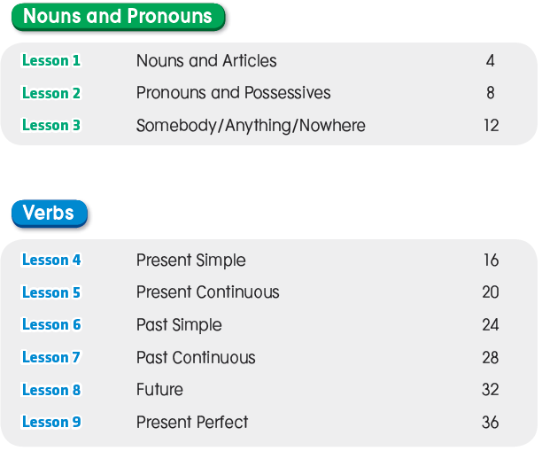
Contents

Slide 3
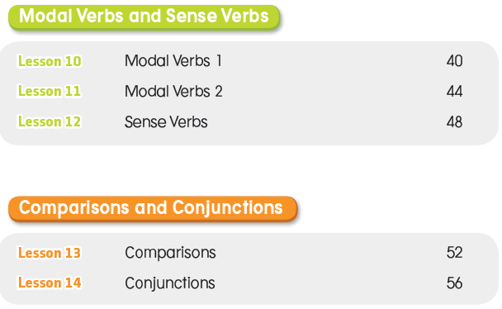
Contents

Slide 4
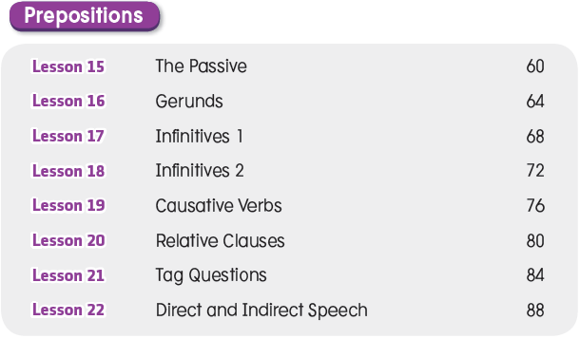
Contents

Slide 5
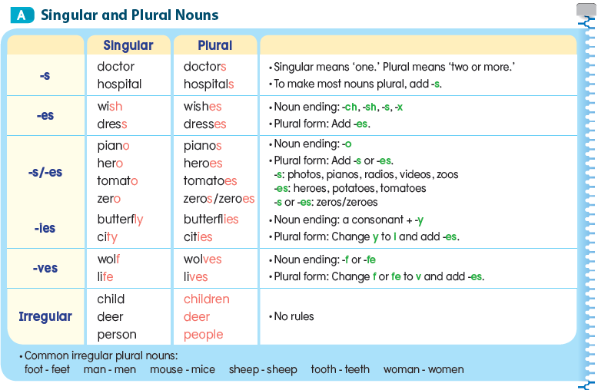
Lesson 1 Nouns and Articles

Slide 6
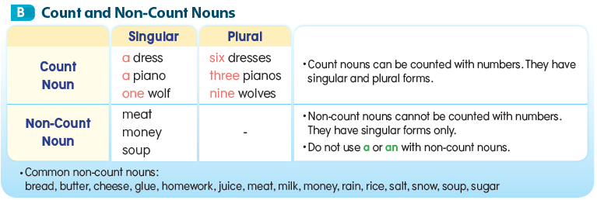

Slide 7
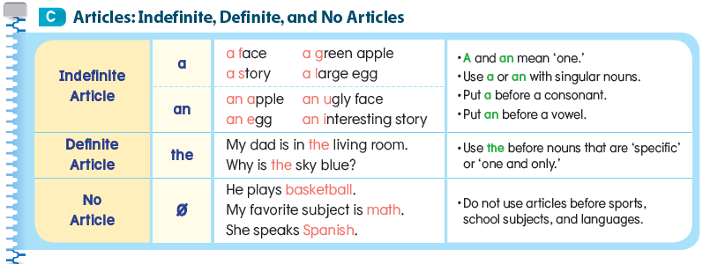

Slide 8
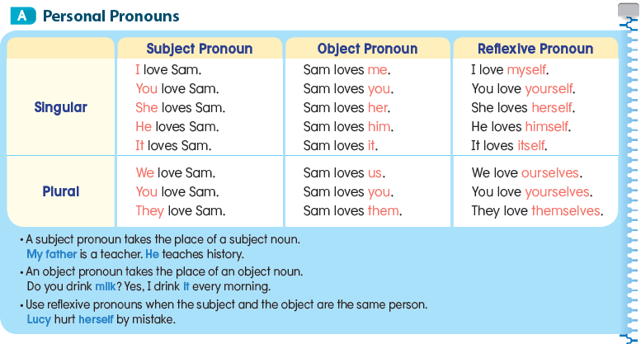
Lesson 2 Pronouns and Possessives

Slide 10
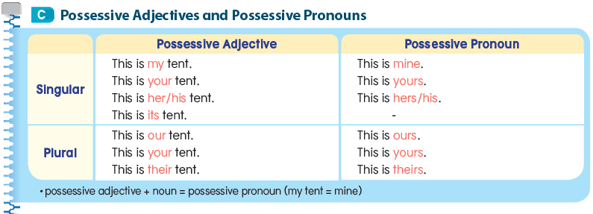

Slide 11
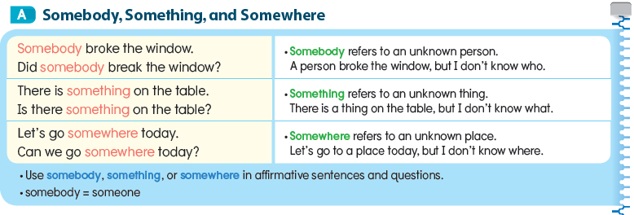
Lesson 3 Somebody/Anything/Nowhere

Slide 14
Lesson 4 Present Simple

Slide 16
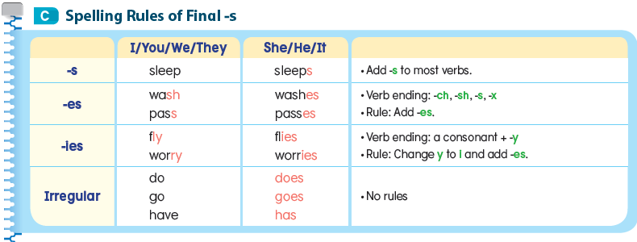

Slide 17
Lesson 5 Present Continuous

Slide 21
Lesson 6 Past Simple

Slide 24
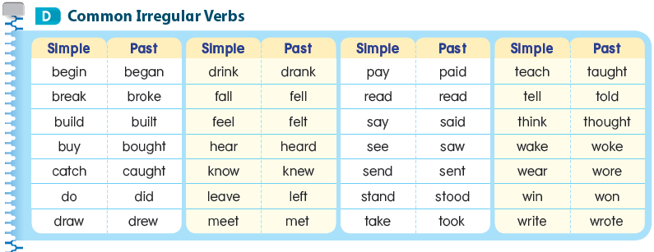

Slide 25
Lesson 7 Past Continuous

Slide 28
Lesson 8 Future

Slide 31
Lesson 9 Present Perfect

Slide 34
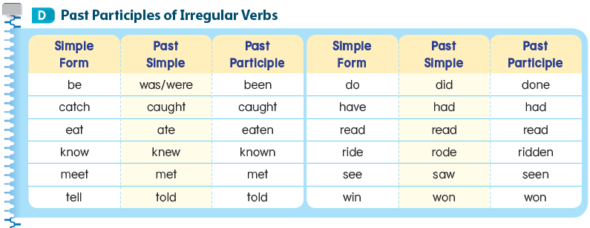

Slide 35
Lesson 10 Modal Verbs 1

Slide 38
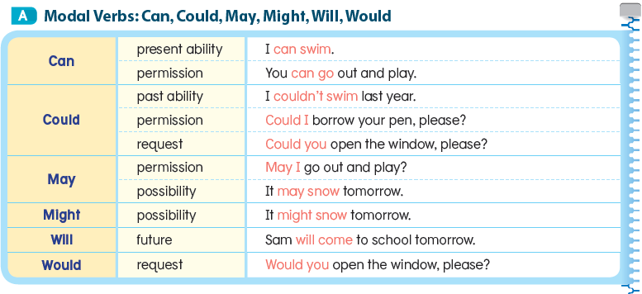
Lesson 11 Modal Verbs 2

Slide 39
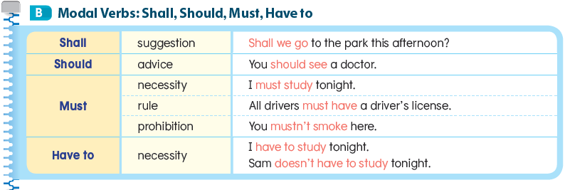

Slide 40
Lesson 12 Sense Verbs

Slide 43
Lesson 13 Comparisons

Slide 44
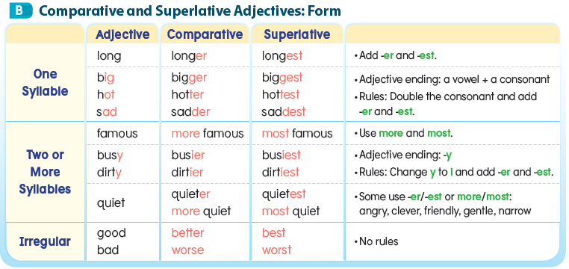

Slide 46
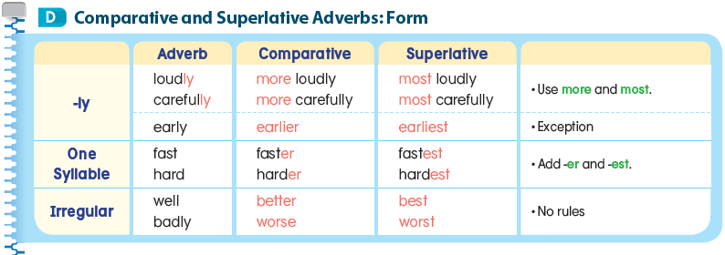

Slide 47
Lesson 14 Conjunctions

Slide 49
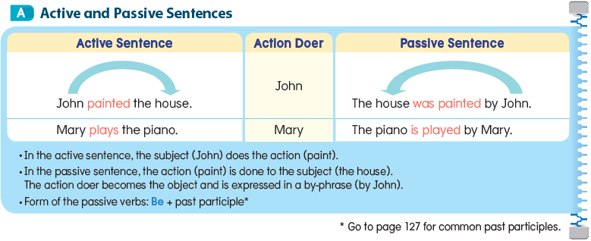
Lesson 15 The Passive

Slide 51
Lesson 16 Gerunds

Slide 54
Lesson 17 Infinitives 1

Slide 57
Lesson 18 Infinitives 2

Slide 59
Lesson 19 Causative Verbs

Slide 63
Lesson 20 Relative Clauses

Slide 66
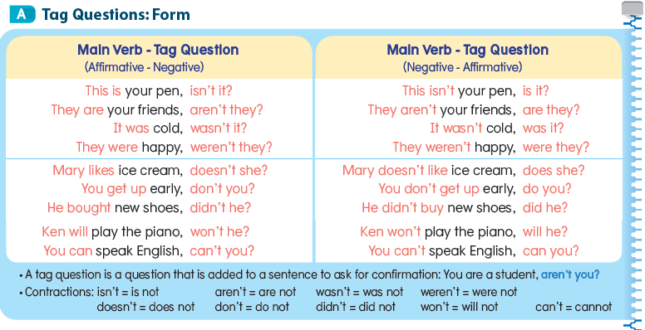
Lesson 21 Tag Questions

Slide 68
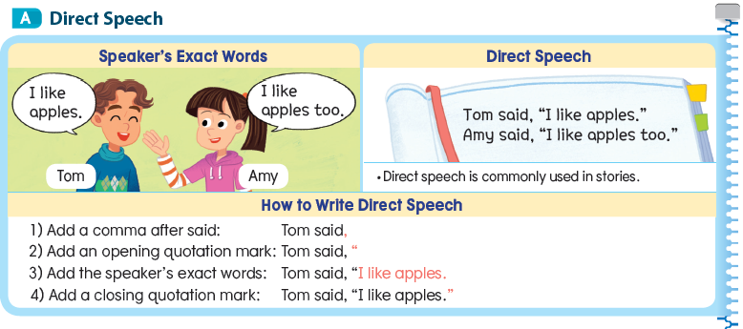
Lesson 22 Direct and Indirect Speech

Slide 69
