Slide 1


Useful Teaching Materials

Slide 2


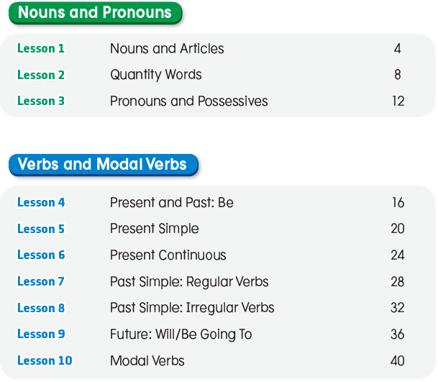

Contents

Slide 3
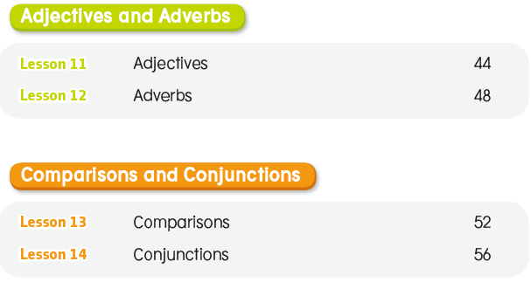
Contents

Slide 4
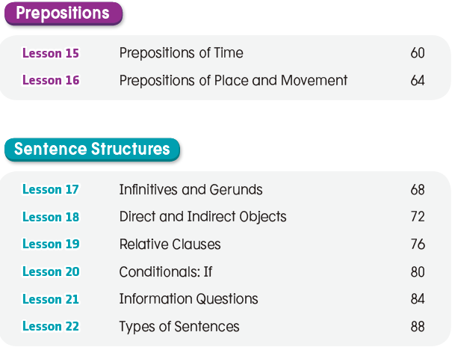
Contents

Slide 5

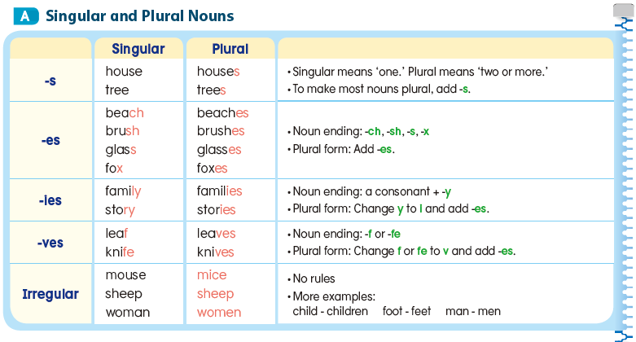
Lesson 1 Nouns and Articles

Slide 6
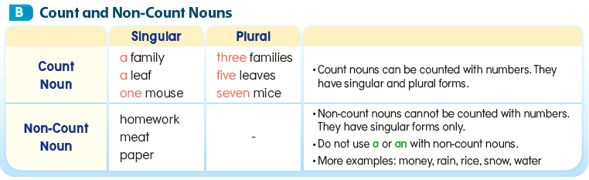

Slide 7
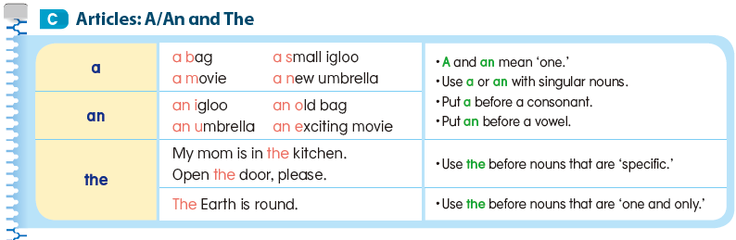

Slide 8
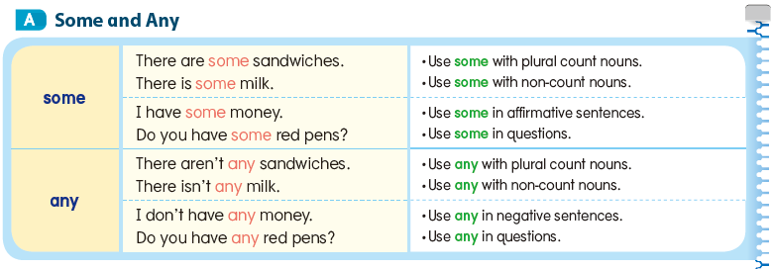
Lesson 2 Quantity Words

Slide 9
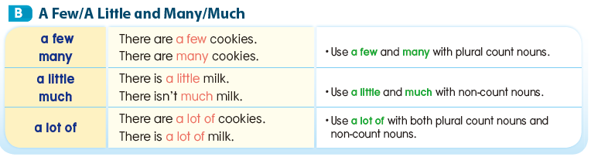

Slide 10
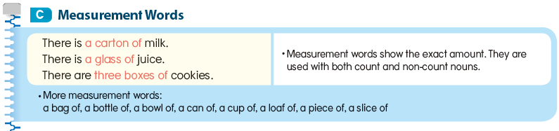

Slide 11
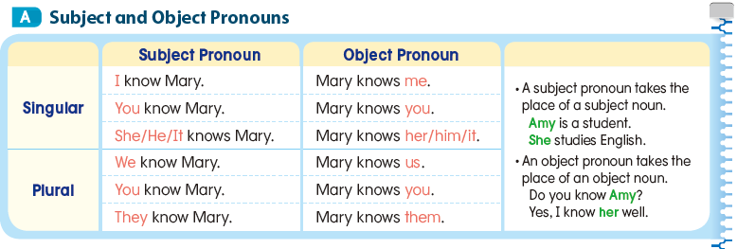
Lesson 3 Pronouns and Possessives

Slide 12
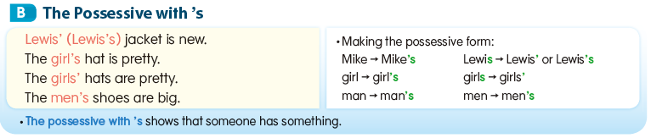

Slide 13
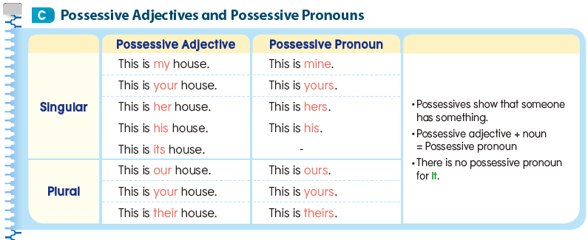

Slide 14
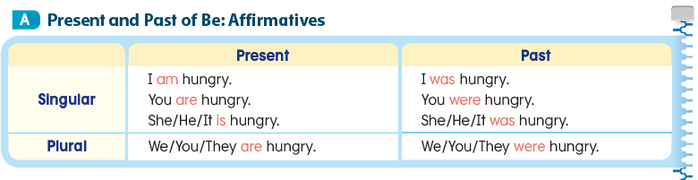
Lesson 4 Present and Past: Be

Slide 15
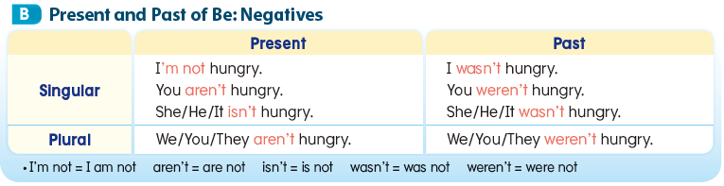

Slide 16
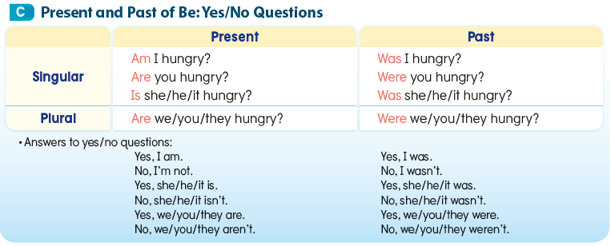

Slide 17
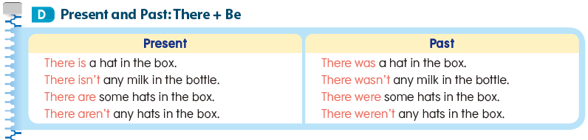

Slide 18
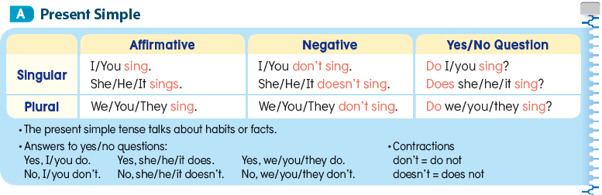
Lesson 5 Present Simple

Slide 19
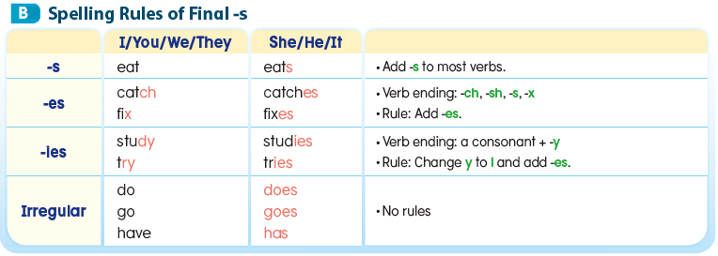

Slide 20
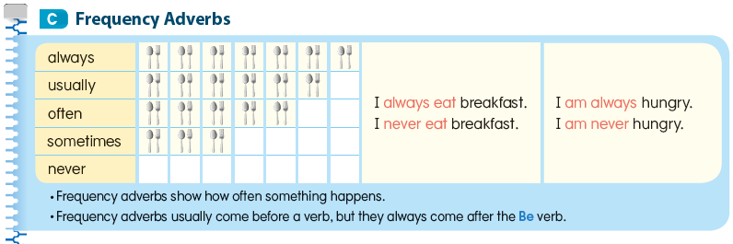

Slide 21
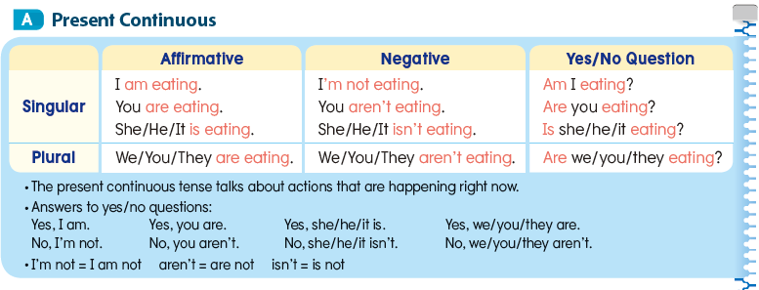
Lesson 6 Present Continuous

Slide 22
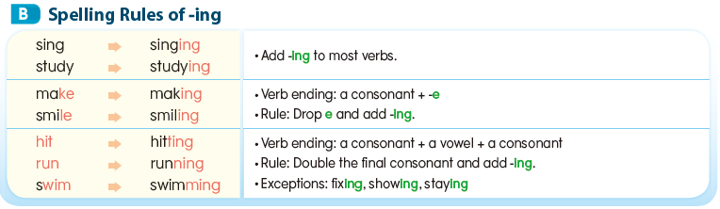

Slide 23
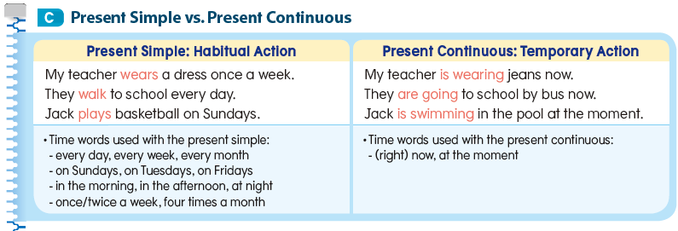

Slide 24
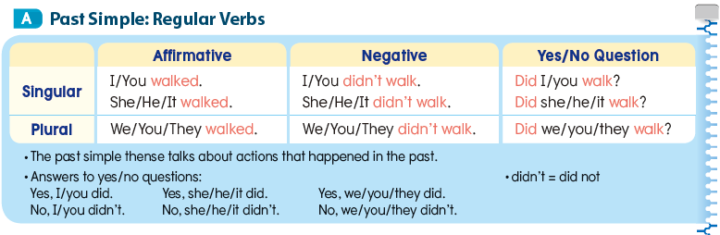
Lesson 7 Past Simple: Regular Verbs

Slide 25
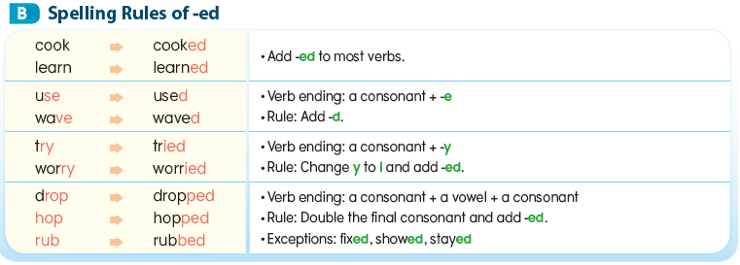

Slide 26
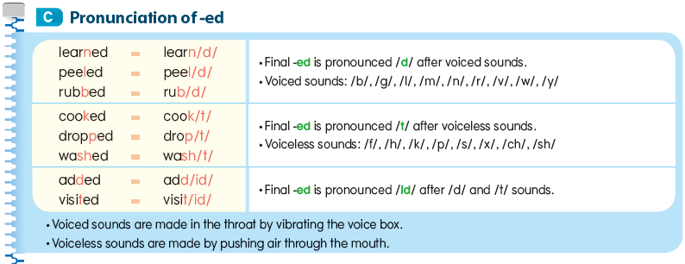

Slide 27
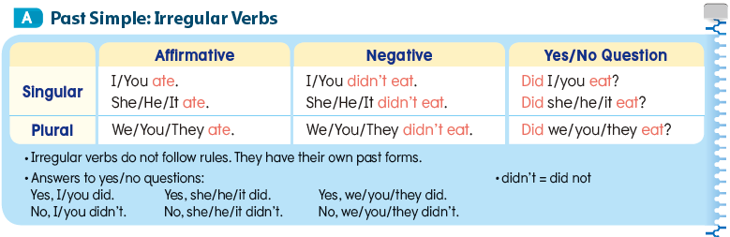
Lesson 8 Past Simple: Irregular Verbs

Slide 28
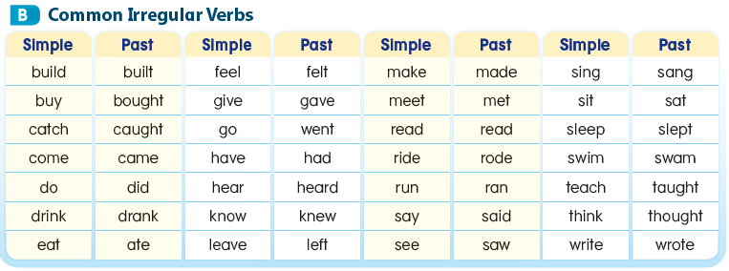

Slide 29
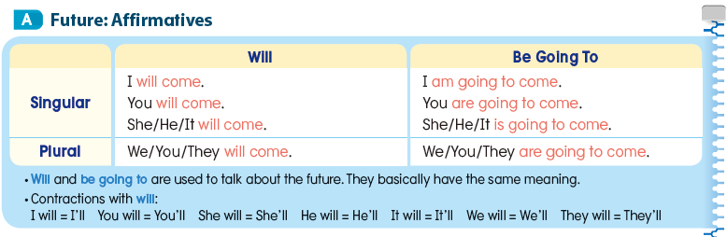
Lesson 9 Future: Will/Be Going To

Slide 30
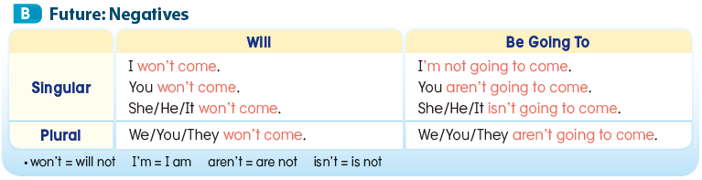

Slide 31
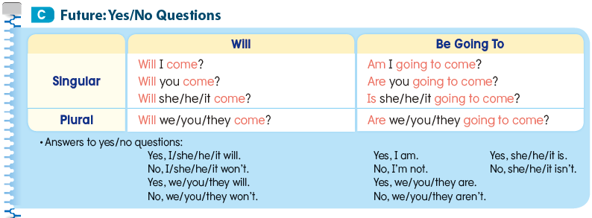

Slide 32
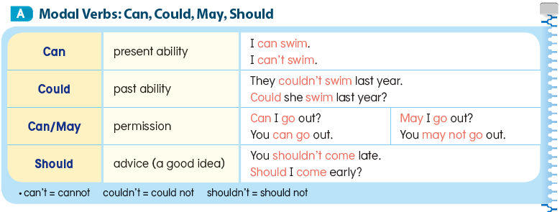
Lesson 10 Modal Verbs

Slide 33
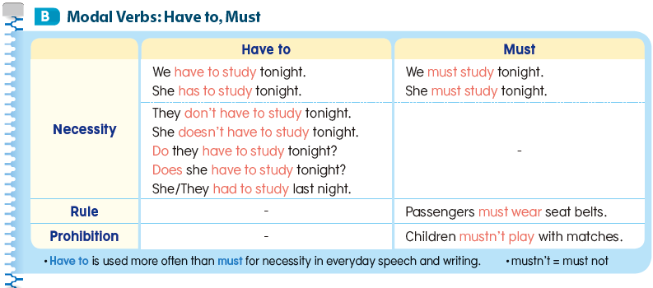

Slide 34
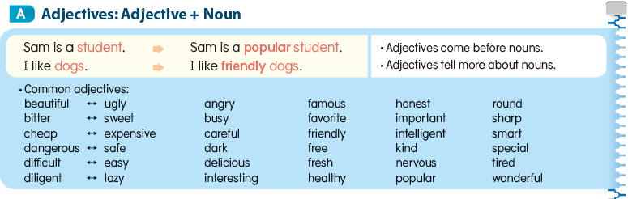
Lesson 11 Adjectives

Slide 35
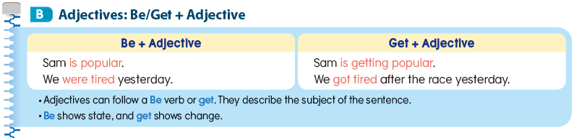

Slide 36
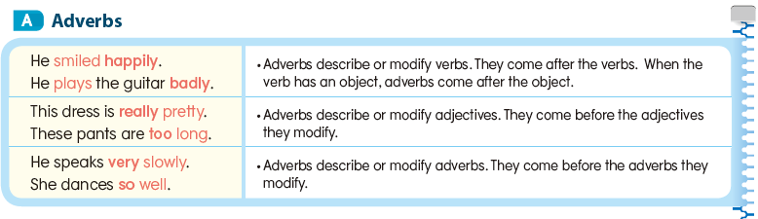
Lesson 12 Adverbs

Slide 37
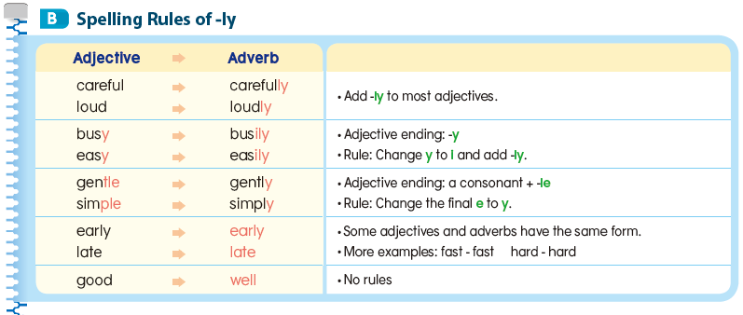

Slide 38
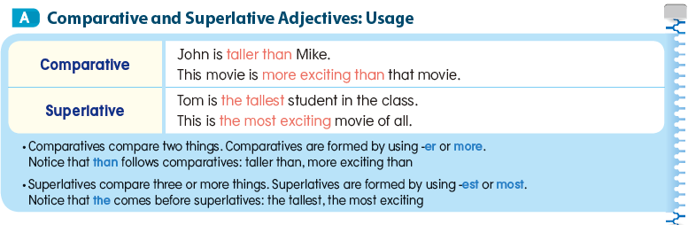
Lesson 13 Comparisons

Slide 39
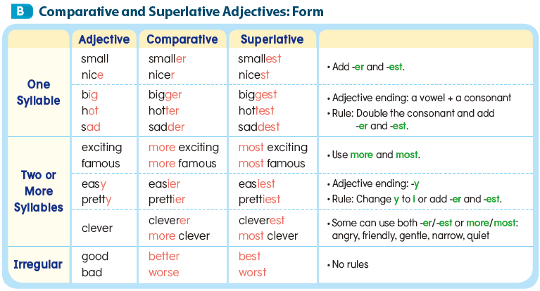

Slide 40
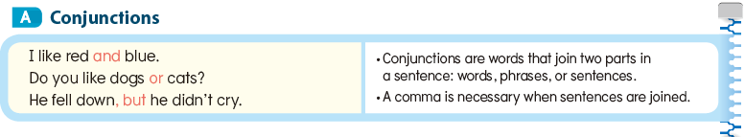
Lesson 14 Conjunctions

Slide 41
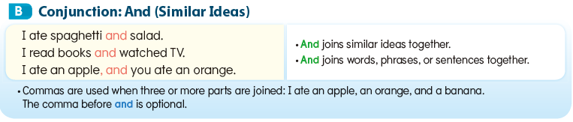

Slide 42
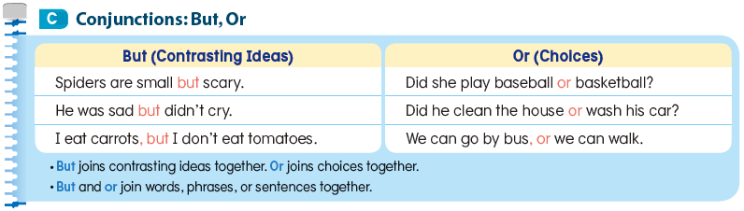

Slide 43
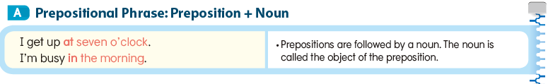
Lesson 15 Prepositions of Time

Slide 44
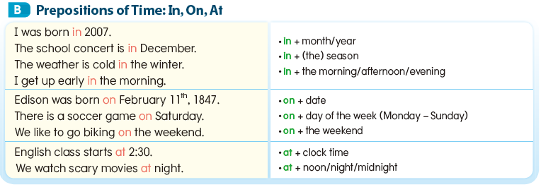

Slide 45
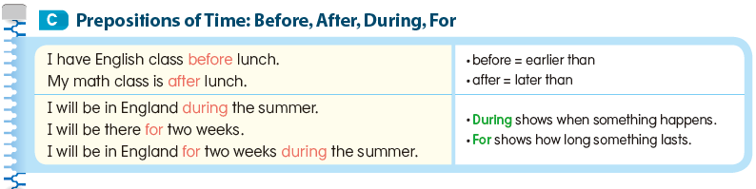

Slide 46
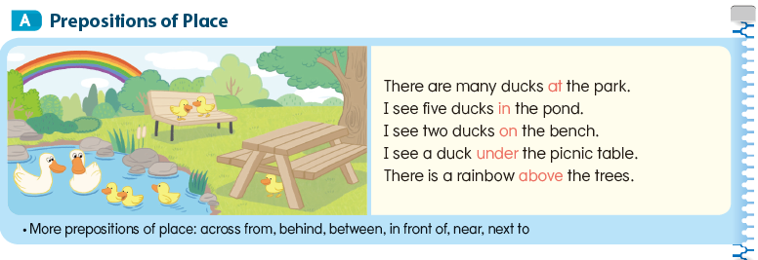
Lesson 16 Prepositions of
Place and Movement

Slide 47
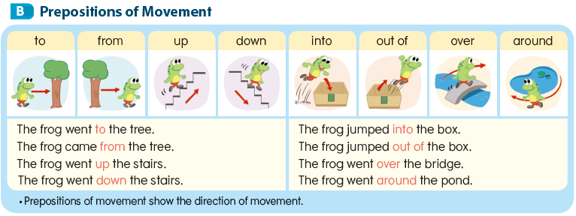

Slide 48
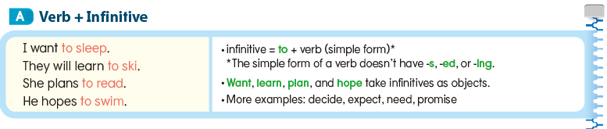
Lesson 17 Infinitives and Gerunds

Slide 49
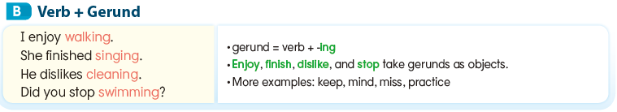

Slide 50
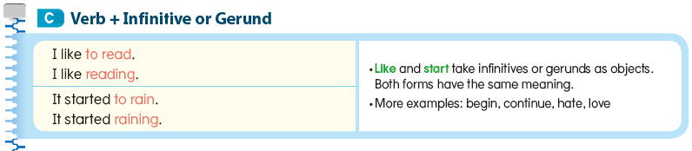

Slide 51
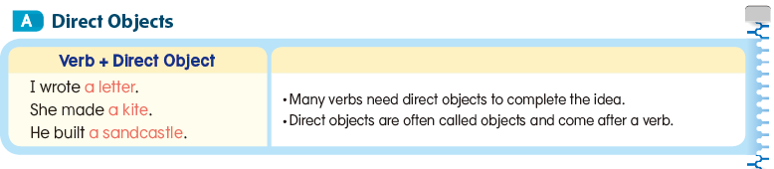
Lesson 18 Direct and Indirect Objects

Slide 52


Slide 53


Slide 54

Lesson 19 Relative Clauses

Slide 55


Slide 56

Lesson 20 Conditionals: If

Slide 57


Slide 58


Slide 59

Lesson 21 Information Questions

Slide 60


Slide 61

Lesson 22 Types of Sentences

Slide 62


Slide 63


Slide 64


