Slide 1
Useful Teaching Materials

Slide 2
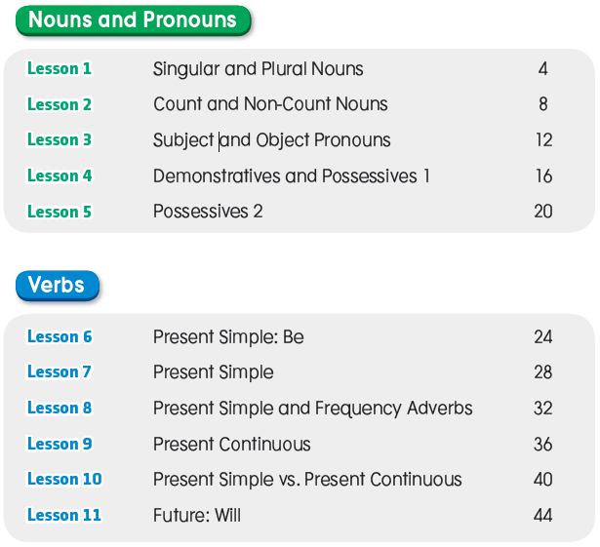
Contents

Slide 3
Contents

Slide 4
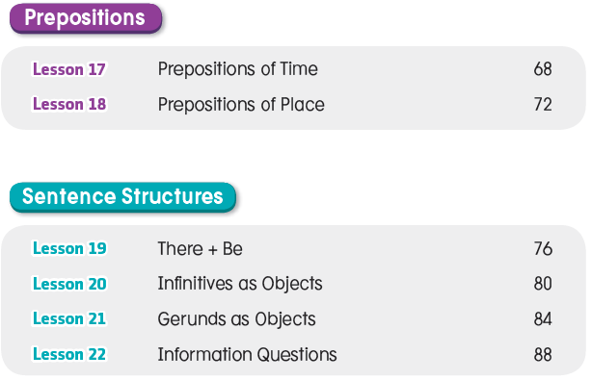
Contents

Slide 5
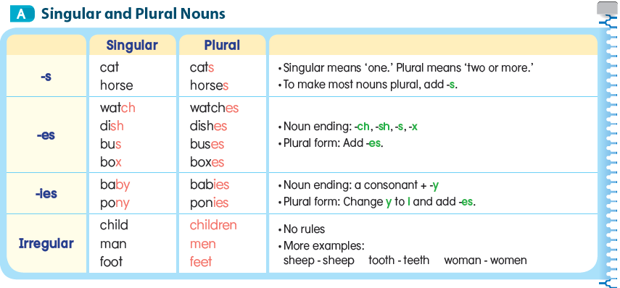
Lesson 1 Singular and Plural Nouns

Slide 7
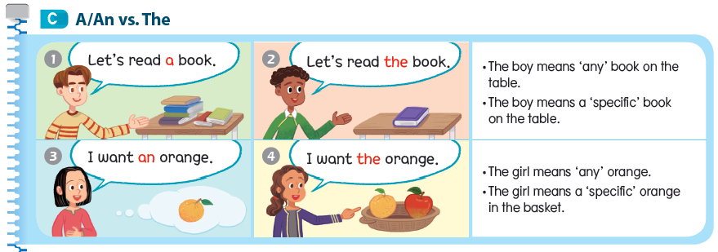

Slide 8
Lesson 2 Count and Non-Count Nouns

Slide 11
Lesson 3 Subject and Object Pronouns

Slide 13
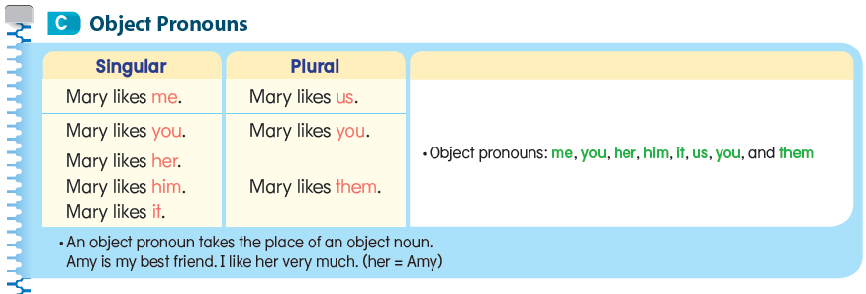

Slide 14
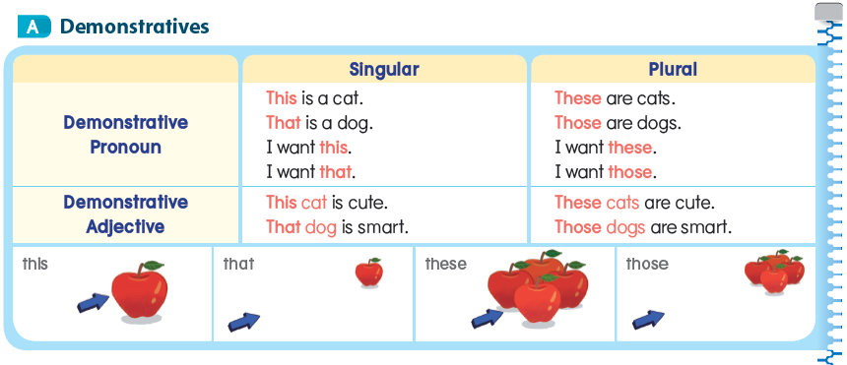
Lesson 4 Demonstratives and Possessive 1

Slide 16
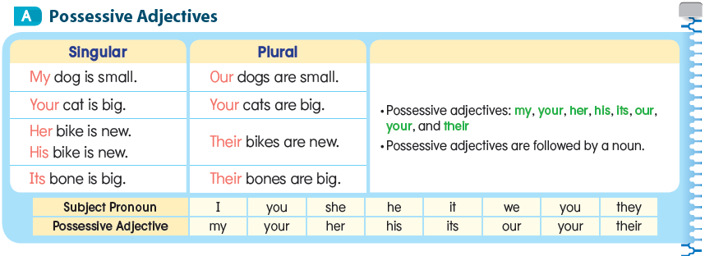
Lesson 5 Possessives 2

Slide 17
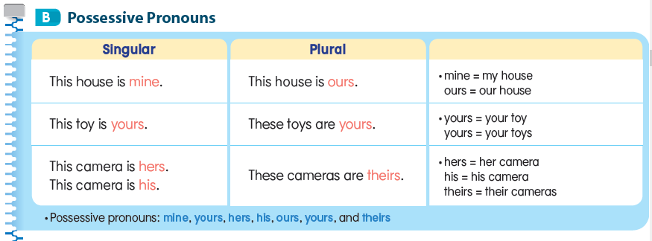

Slide 18
Lesson 6 Present Simple: Be

Slide 21
Lesson 7 Present Simple

Slide 22
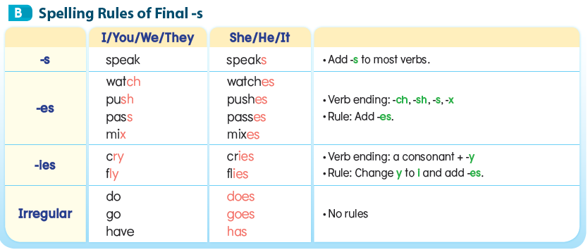

Slide 24
Lesson 8 Present Simple and
Frequency Adverbs

Slide 26
Lesson 9 Present Continuous

Slide 29
Lesson 10 Present Simple vs.
Present Continuous

Slide 32
Lesson 11 Future: Will

Slide 34
Lesson 12 Past Simple: Regular Verbs

Slide 35
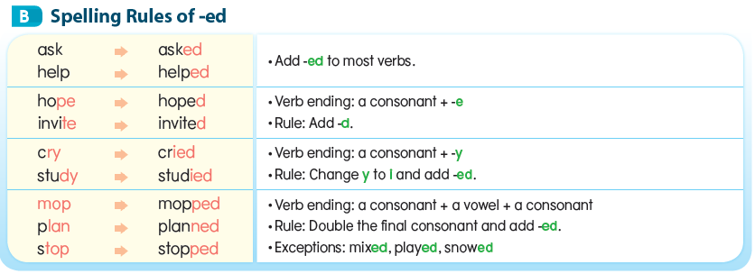

Slide 37
Lesson 13 Past Simple:
Irregular Verbs and Be

Slide 39
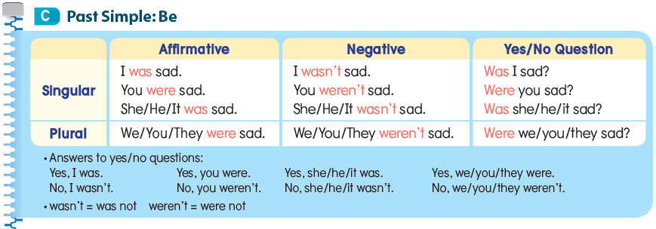

Slide 40
Lesson 14 Modal Verbs

Slide 43
Lesson 15 Adjectives

Slide 46
Lesson 16 Adverbs

Slide 48
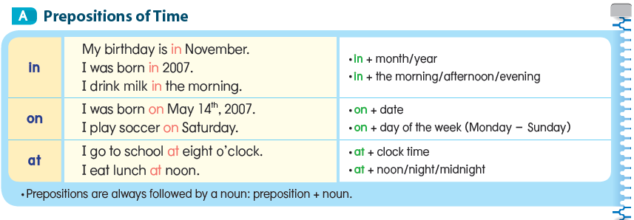
Lesson 17 Prepositions of Time

Slide 49
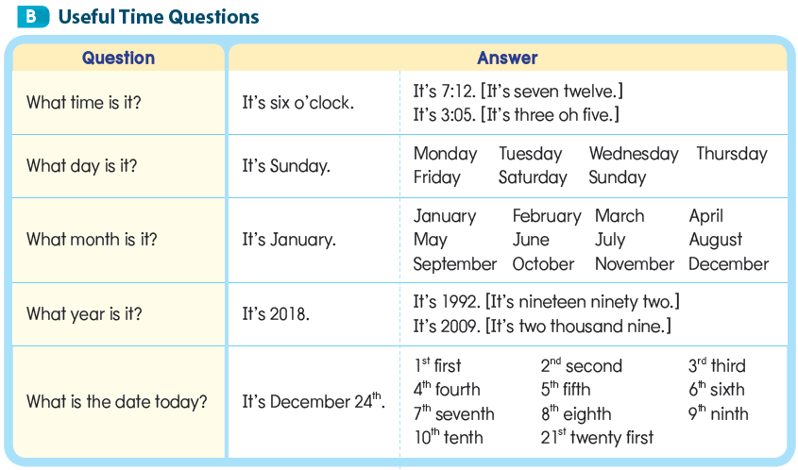

Slide 50
Lesson 18 Prepositions of Place

Slide 51
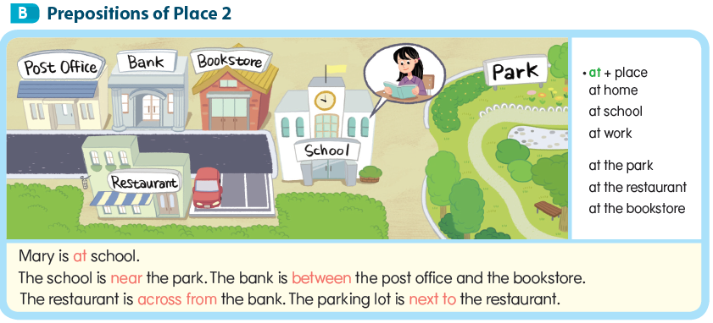

Slide 52
Lesson 19 There + Be

Slide 55
Lesson 20 Infinitives as Objects

Slide 58
Lesson 21 Gerunds as Objects

Slide 61
Lesson 22 Information Questions

